Slide 1


Addition/ Elimination Chemiluminescence
Mason Swanton

Slide 2

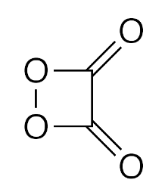
Background
Chemiluminescence
HEI 1,2-Dioxetanedione

Slide 3
Reaction
Step 1: Aromatic addition/elimination

Slide 4
Reaction
Step 2: Nucleophilic pyridine attack and peroxide addition/elimination

Slide 5
Reaction
Step 3: Choice of NUCLEOPHILIC catalyzed (High []) or BASE catalyzed (low [])
Base
Nuc:

Slide 6
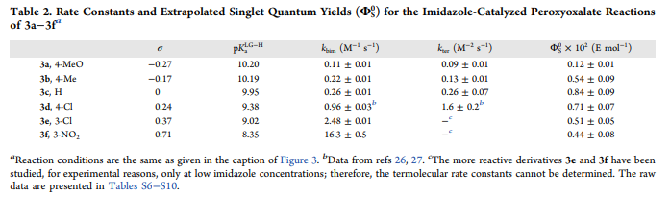


Conditions:
First step is simply sealed and under room temperature
Why pyridine? Pyridine is used as a weak base and to prevent deprotonation of products
What is X? Not a halogen, but instead any group meant to affect the rate constants
As phenolate became a better leaving group, rate constants increased
The X group also affected singlet quantum yields
Higher quantum yields = higher fluorescence

Slide 7
Product
Our HEI 1,2-Dioxetanedione
This HEI excites fluorescence dyes via electron transfer chemistry
This causes chemiluminescence (seen in glow sticks)
Only 30% yield through this reaction
Product was identified using NMR C¹³

Slide 8
References:
Sandra M. da Silva, André P. Lang, Ana Paula F. dos Santos, et al.The Journal of Organic Chemistry Cyclic Peroxidic Carbon Dioxide Dimer Fuels Peroxyoxalate Chemiluminescence 2021, https://pubs.acs.org/doi/pdf/10.1021/acs.joc.1c00929

