Slide 1
Determination of Riboflavin (Vitamin B2) and Caffeine in Energy Drinks Using HPLC with Fluorescence detection/UV-VIS
Garrett Grubisa, Mason Swanton and Gursevak Uppal

Slide 2
Background
Name | REC. DAILY INTAKE | AMOUNT IN CAN | RISKS
Riboflavin | 1.3 mg | 5.8 ppm | Diarrhea Increased urine Bright yellow urine.
Caffeine | 400 mg | 351 ppm | Irregular heartbeat Seizures.
Notes:
Now, our objective was to compare the concentrations of riboflavin and caffeine with the amount labelled. We then wanted to compare these concentrations with the daily intake values. For riboflavin, the daily intake value is 1.3mg, if you exceed this amount you are then at risk for health risks such as diarrhea or increased urine and even urine turning a bright yellow.
Whereas, for caffeine, the daily intake value is 400mg, if the 400mg is exceeded then you are at risk for irregular heartbeat and seizures.
Graphic idea: (Green check > (underneath arrow put the intake value) red arrow (underneath list all the negative health effects)

Slide 3
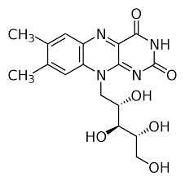
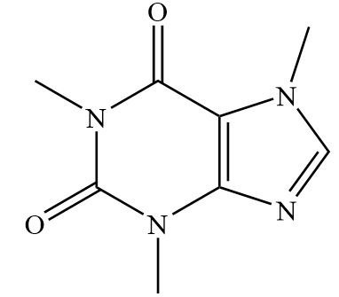
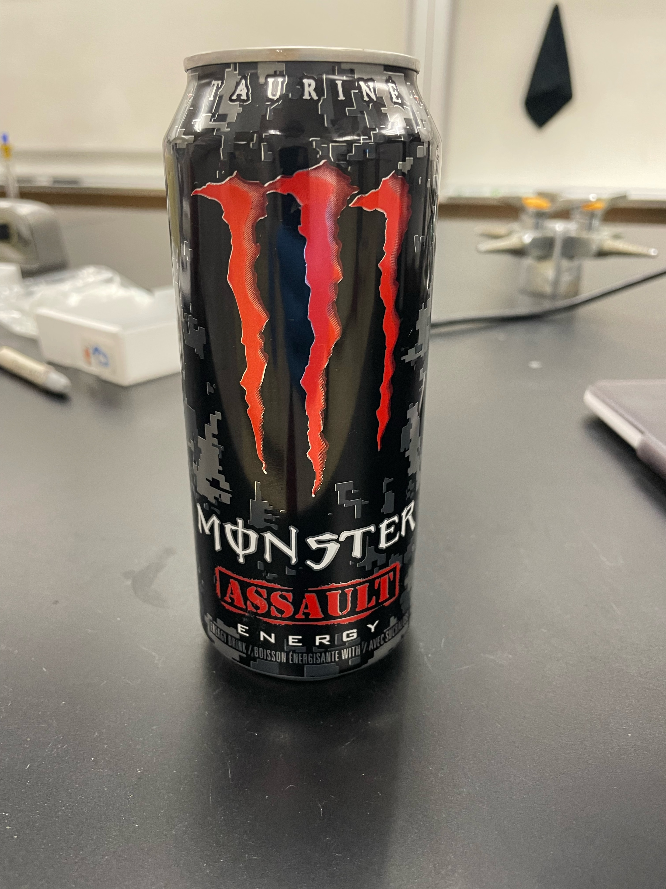
Question:
Can riboflavin and caffeine be quantitatively determined in a can of Monster Energy?
Figure 1. Structure of Riboflavin C­₁₇H₂₀N₄O₆
Figure 3. Structure of Caffeine C₈H₁₀N₄O₂
Figure 2. Monster Energy Assault (Real Sample)
Notes:
Our main goal for the experiment was to quantitatively determine concentrations of riboflavin and caffeine in a can of Monster energy assault.
Riboflavin also known as Vitamin B2 is a vitamin found in food and is advertised as a dietary supplement.
Caffeine is the major active component of energy drinks such as the monster energy assault.

Slide 4
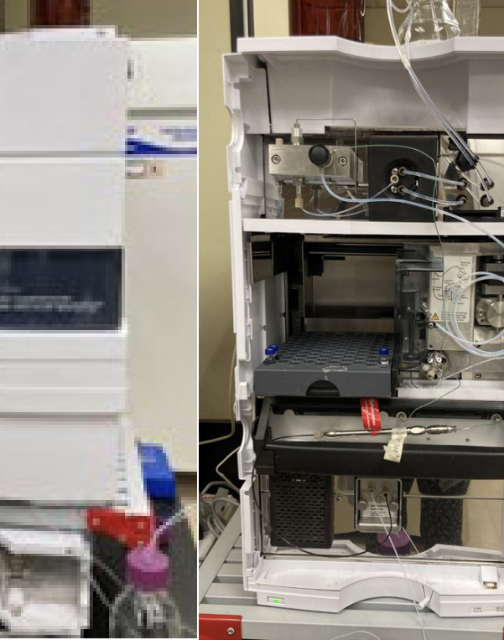
Instrument
 | Riboflavin | Caffeine
HPLC Detector(s) | Fluroscent and UV/Vis | UV/Vis
Flow Rate | 0.5 mL/min | 0.5 mL/min
Column | Kinetex 2.6 µm Polar C18 100 A | Kinetex 2.6mm EVO C18 100 A LC column
Mobile phase | Acetonitrile-phosphate buffer (50mM, pH 3.00) 20:80 (v/v) | 0.5% Acetic acid-Methanol 75:25 (v/v)
Wavelength | Excitation/Emission: 450 nm/530 nm | 273 nm

Slide 5
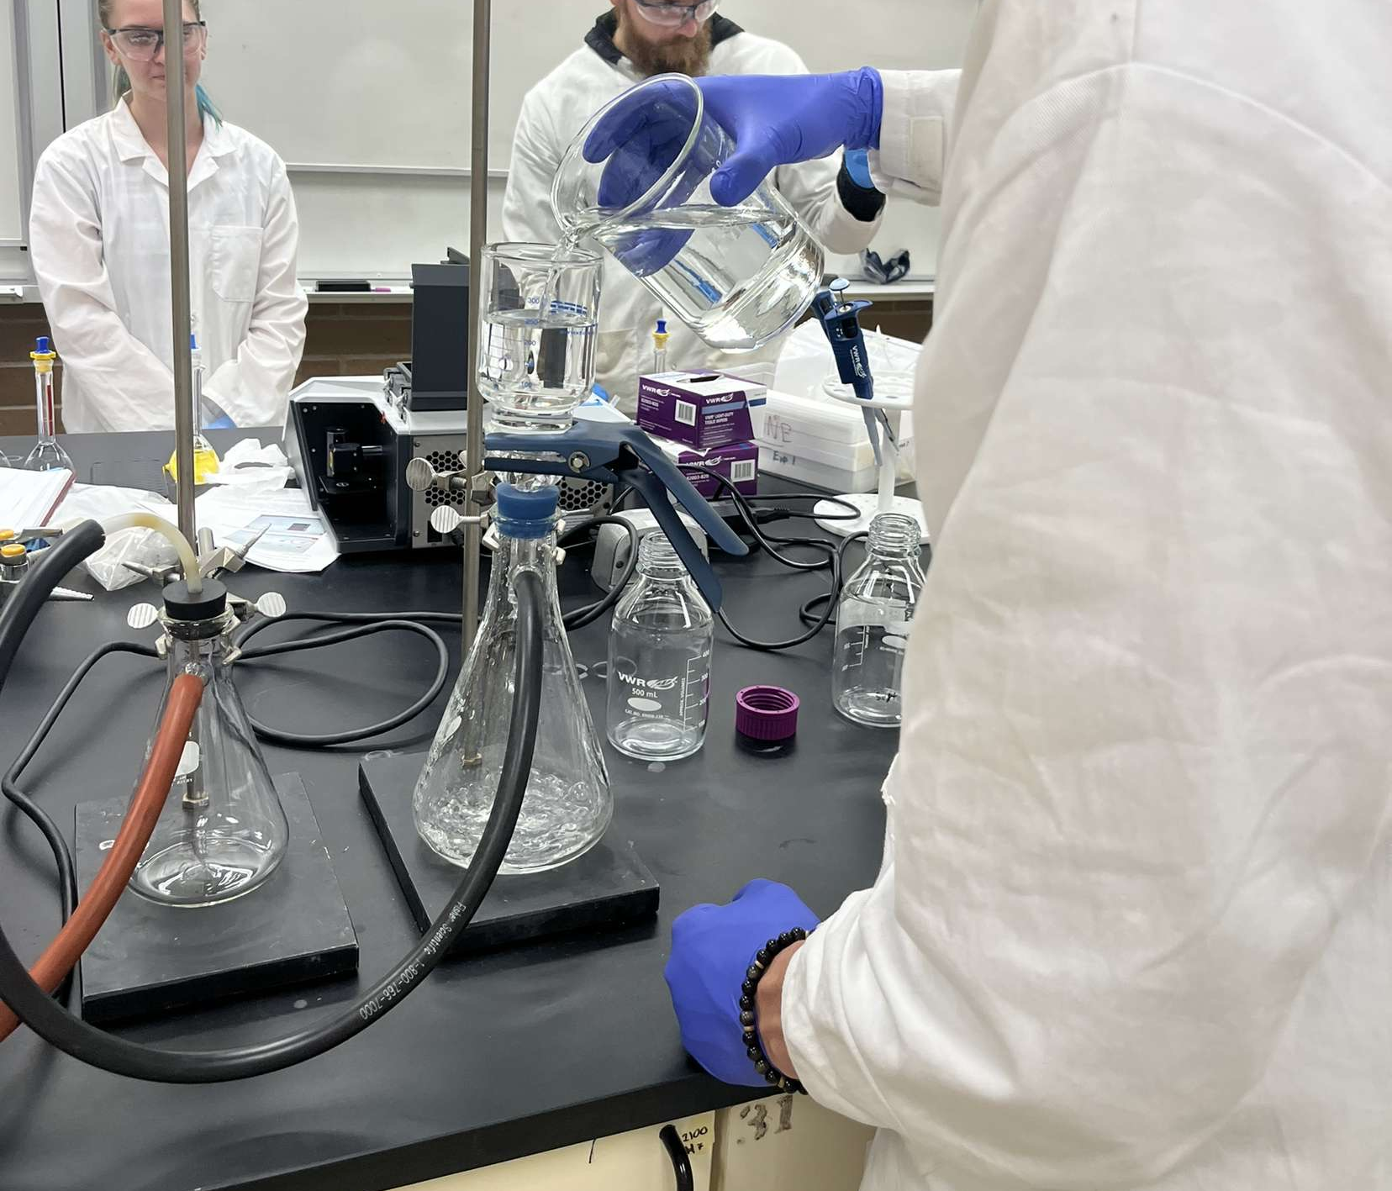
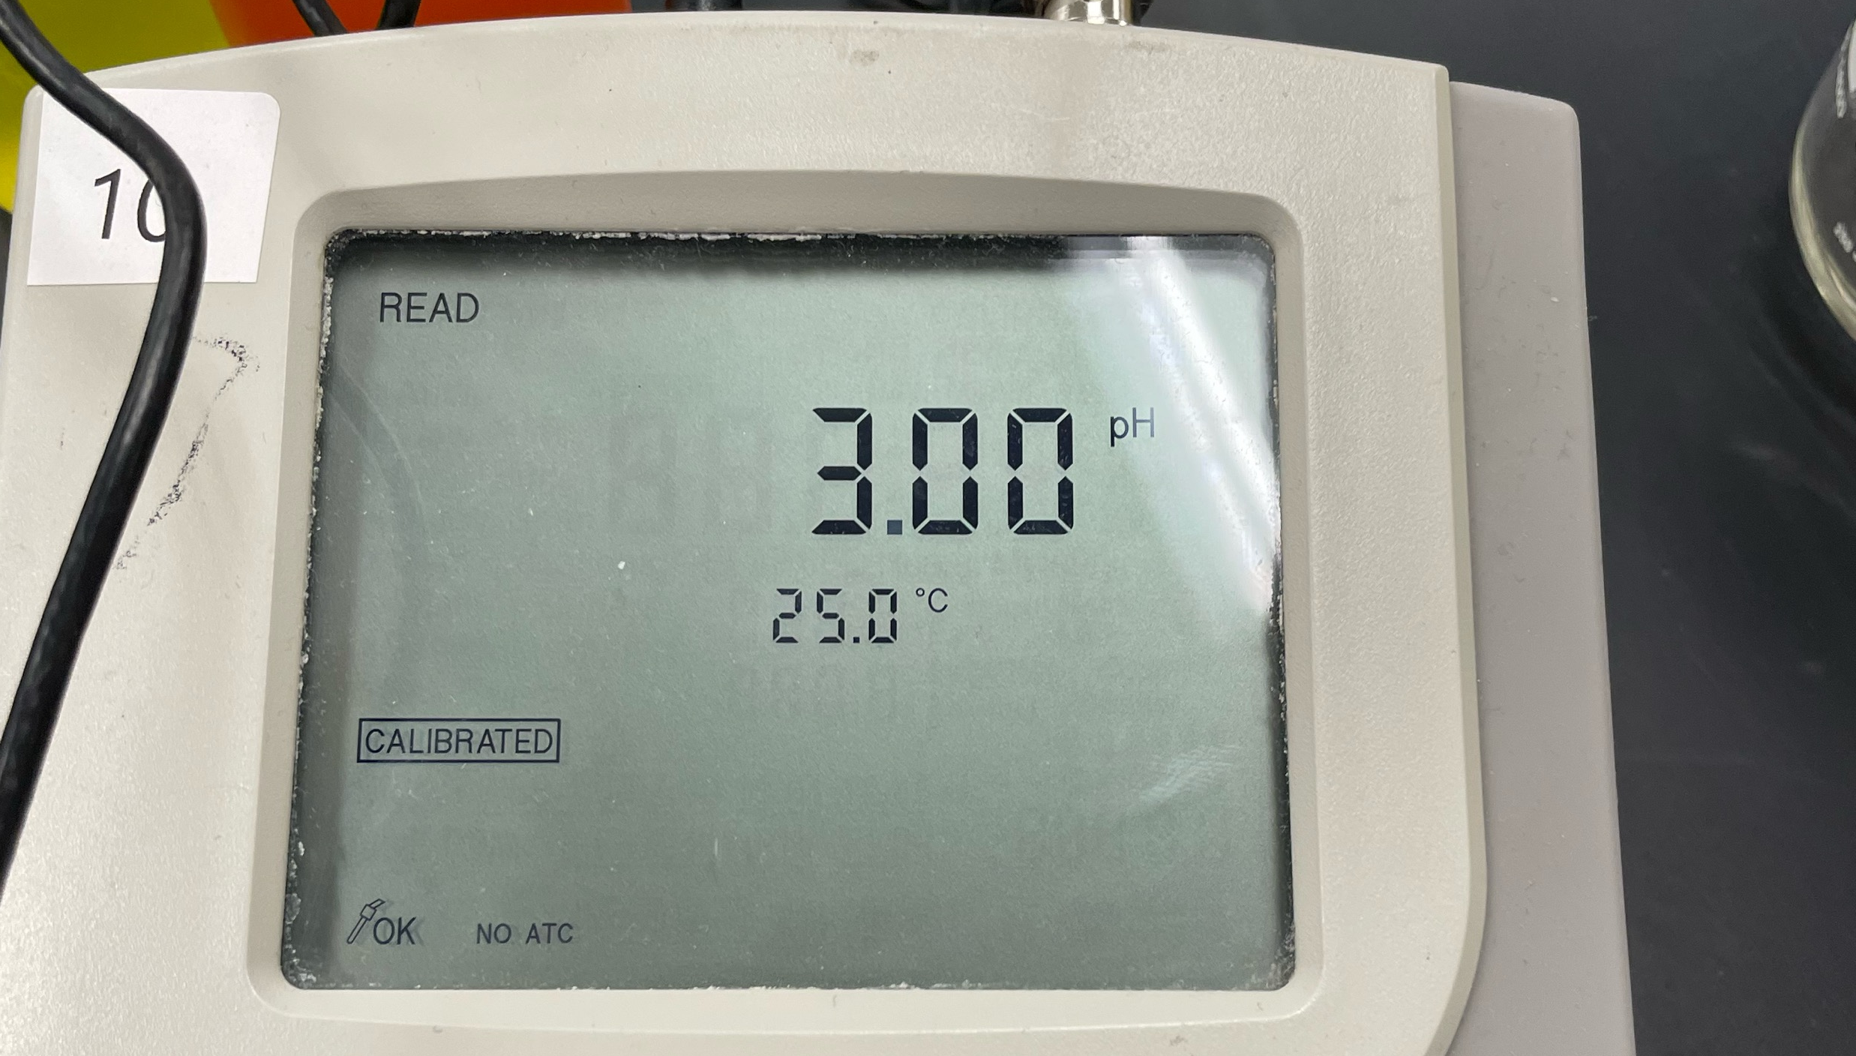
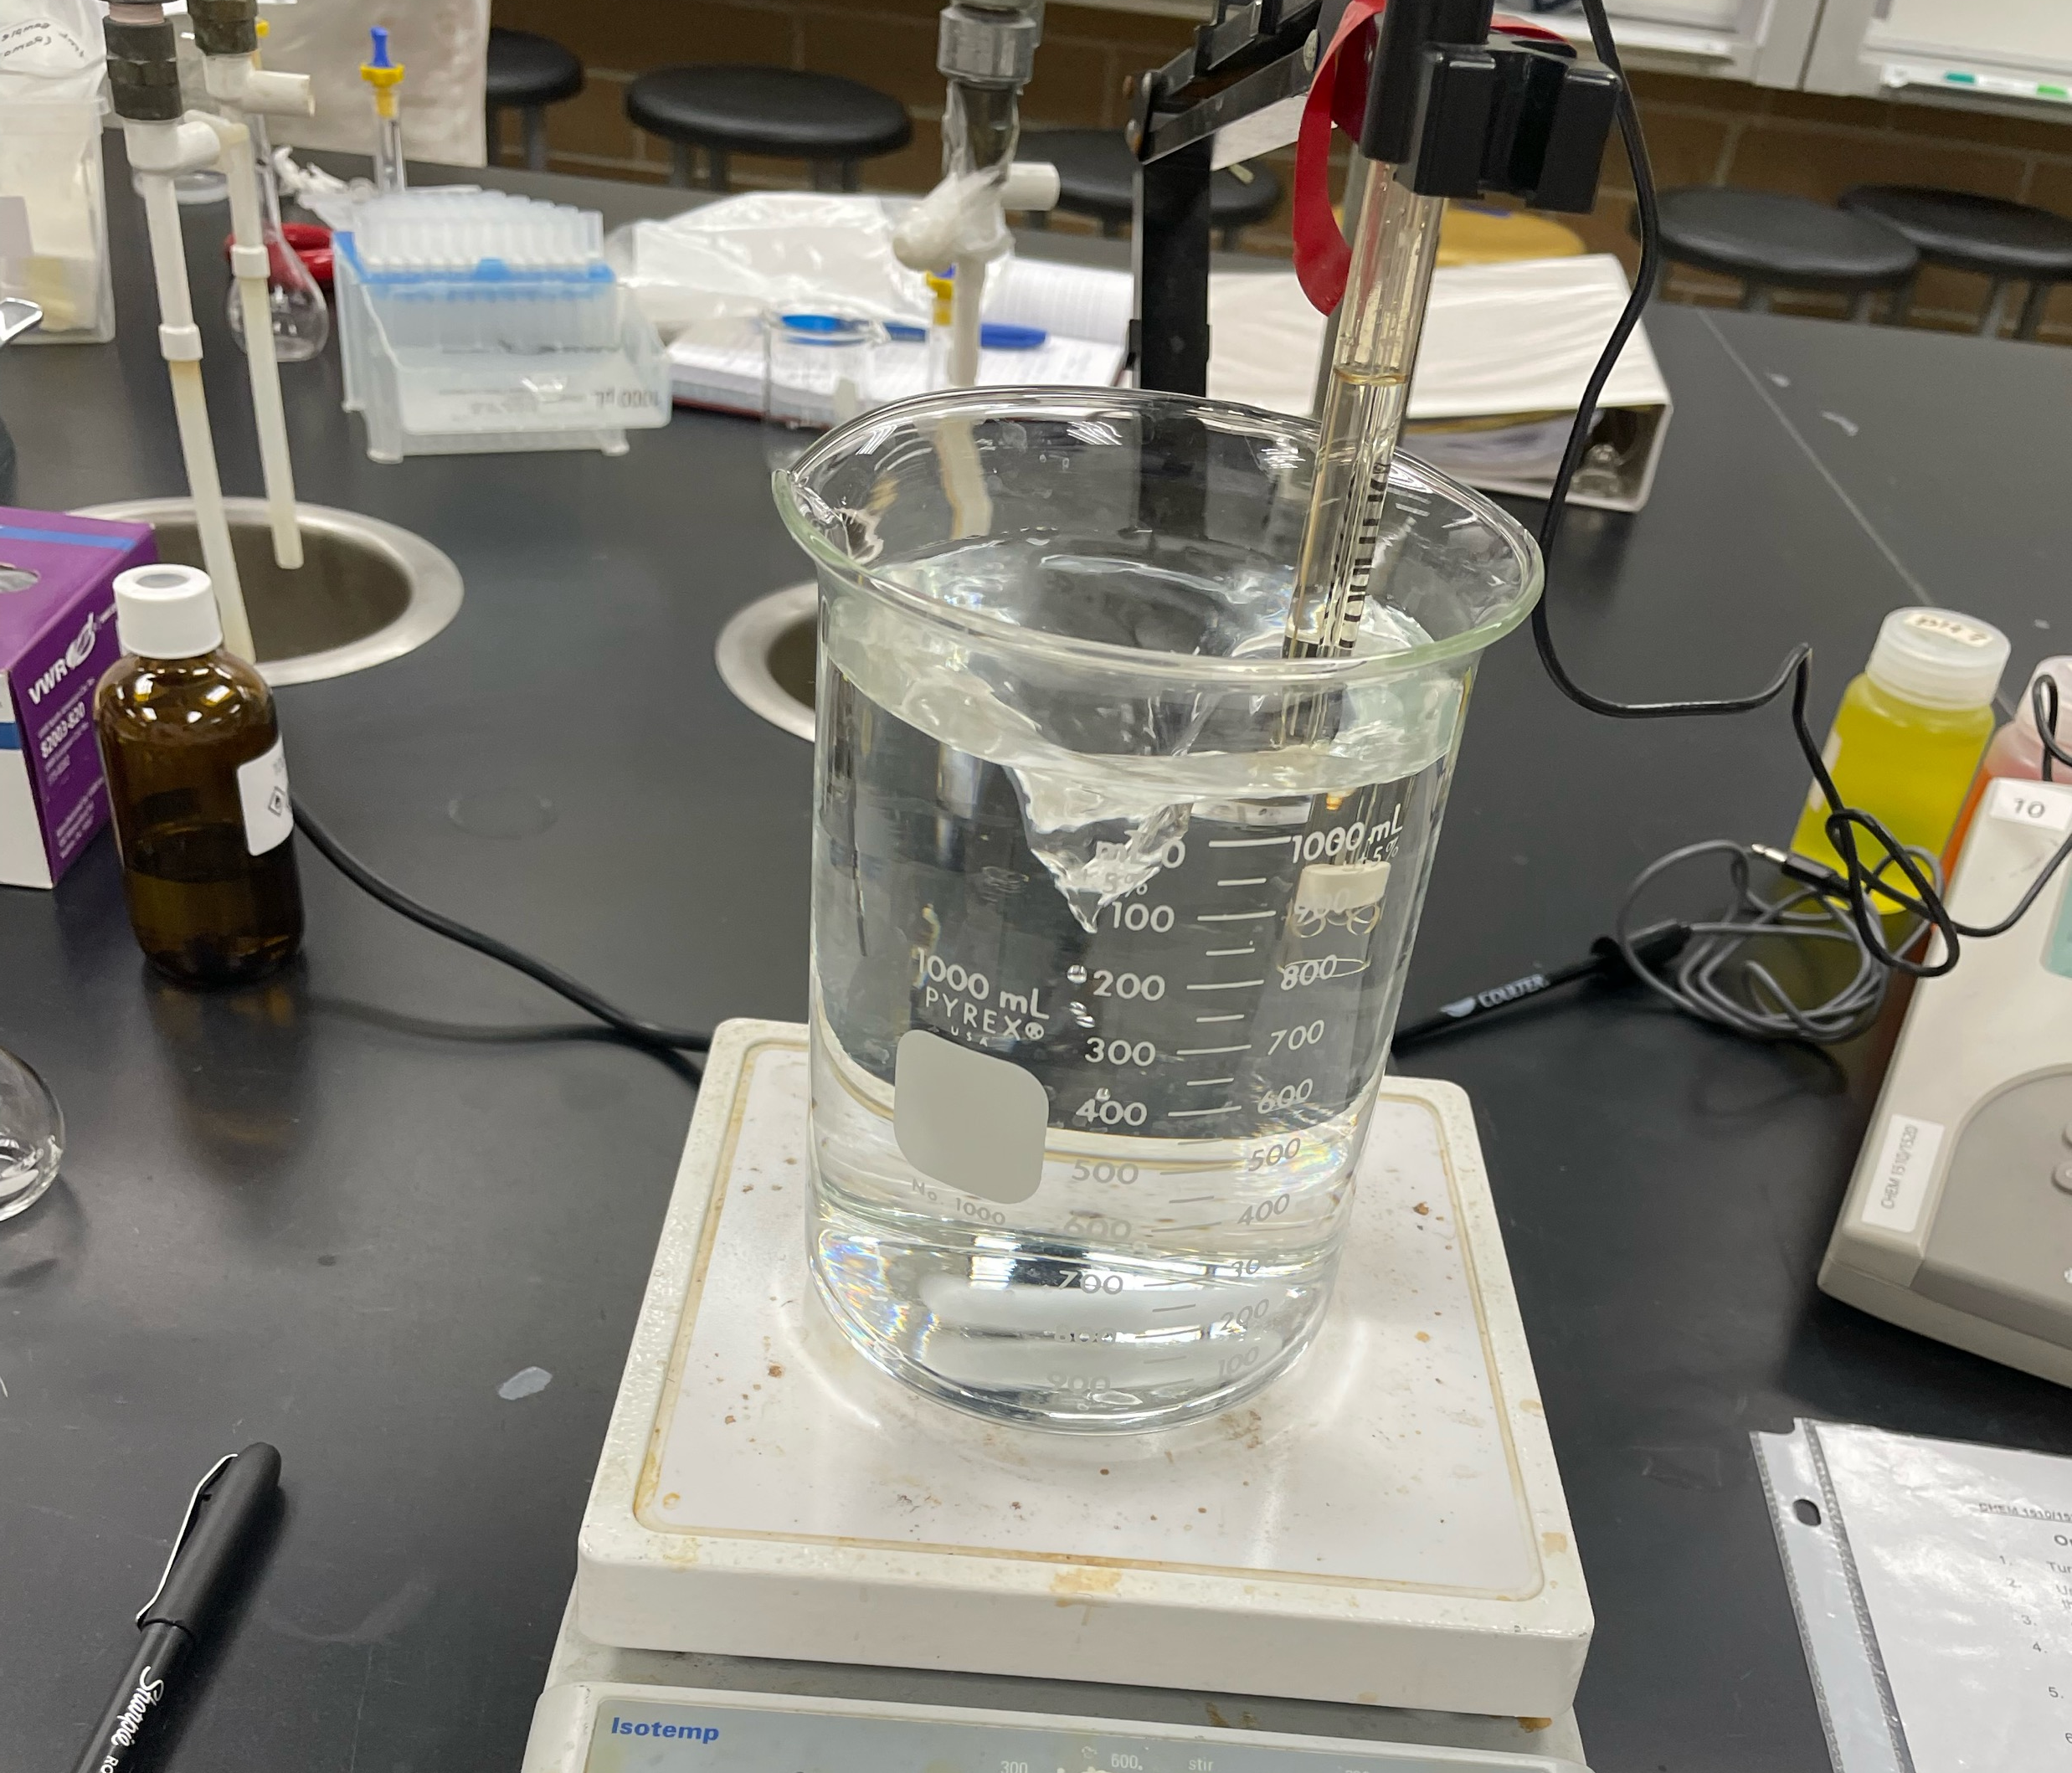
Phosphate Buffer Solution
50mM
3.00 pH
1.00 L
Notes:
So for our riboflavin concentration determination, the paper we had found that conducted a very similar experiment, used a sodium-phosphate buffer solution for their Organic solvent. Fortunately, there was none already prepared so we got to gain the experience of creating a buffer solution which Mason and Garrett had not done before. We weighed out a mass of sodium phosphate that allowed us to get a concentration of 50mM in a 1L beaker, Then we altered the pH of the solution by adding 1M HCl to the beaker until the pH was 3.00
The solution was then filtered through a vacuum apparatus – very similar to a buchner vacuum filtration in Ochem – to remove any particules – basically faster than using the 0.2 luer lock filters.

Slide 6
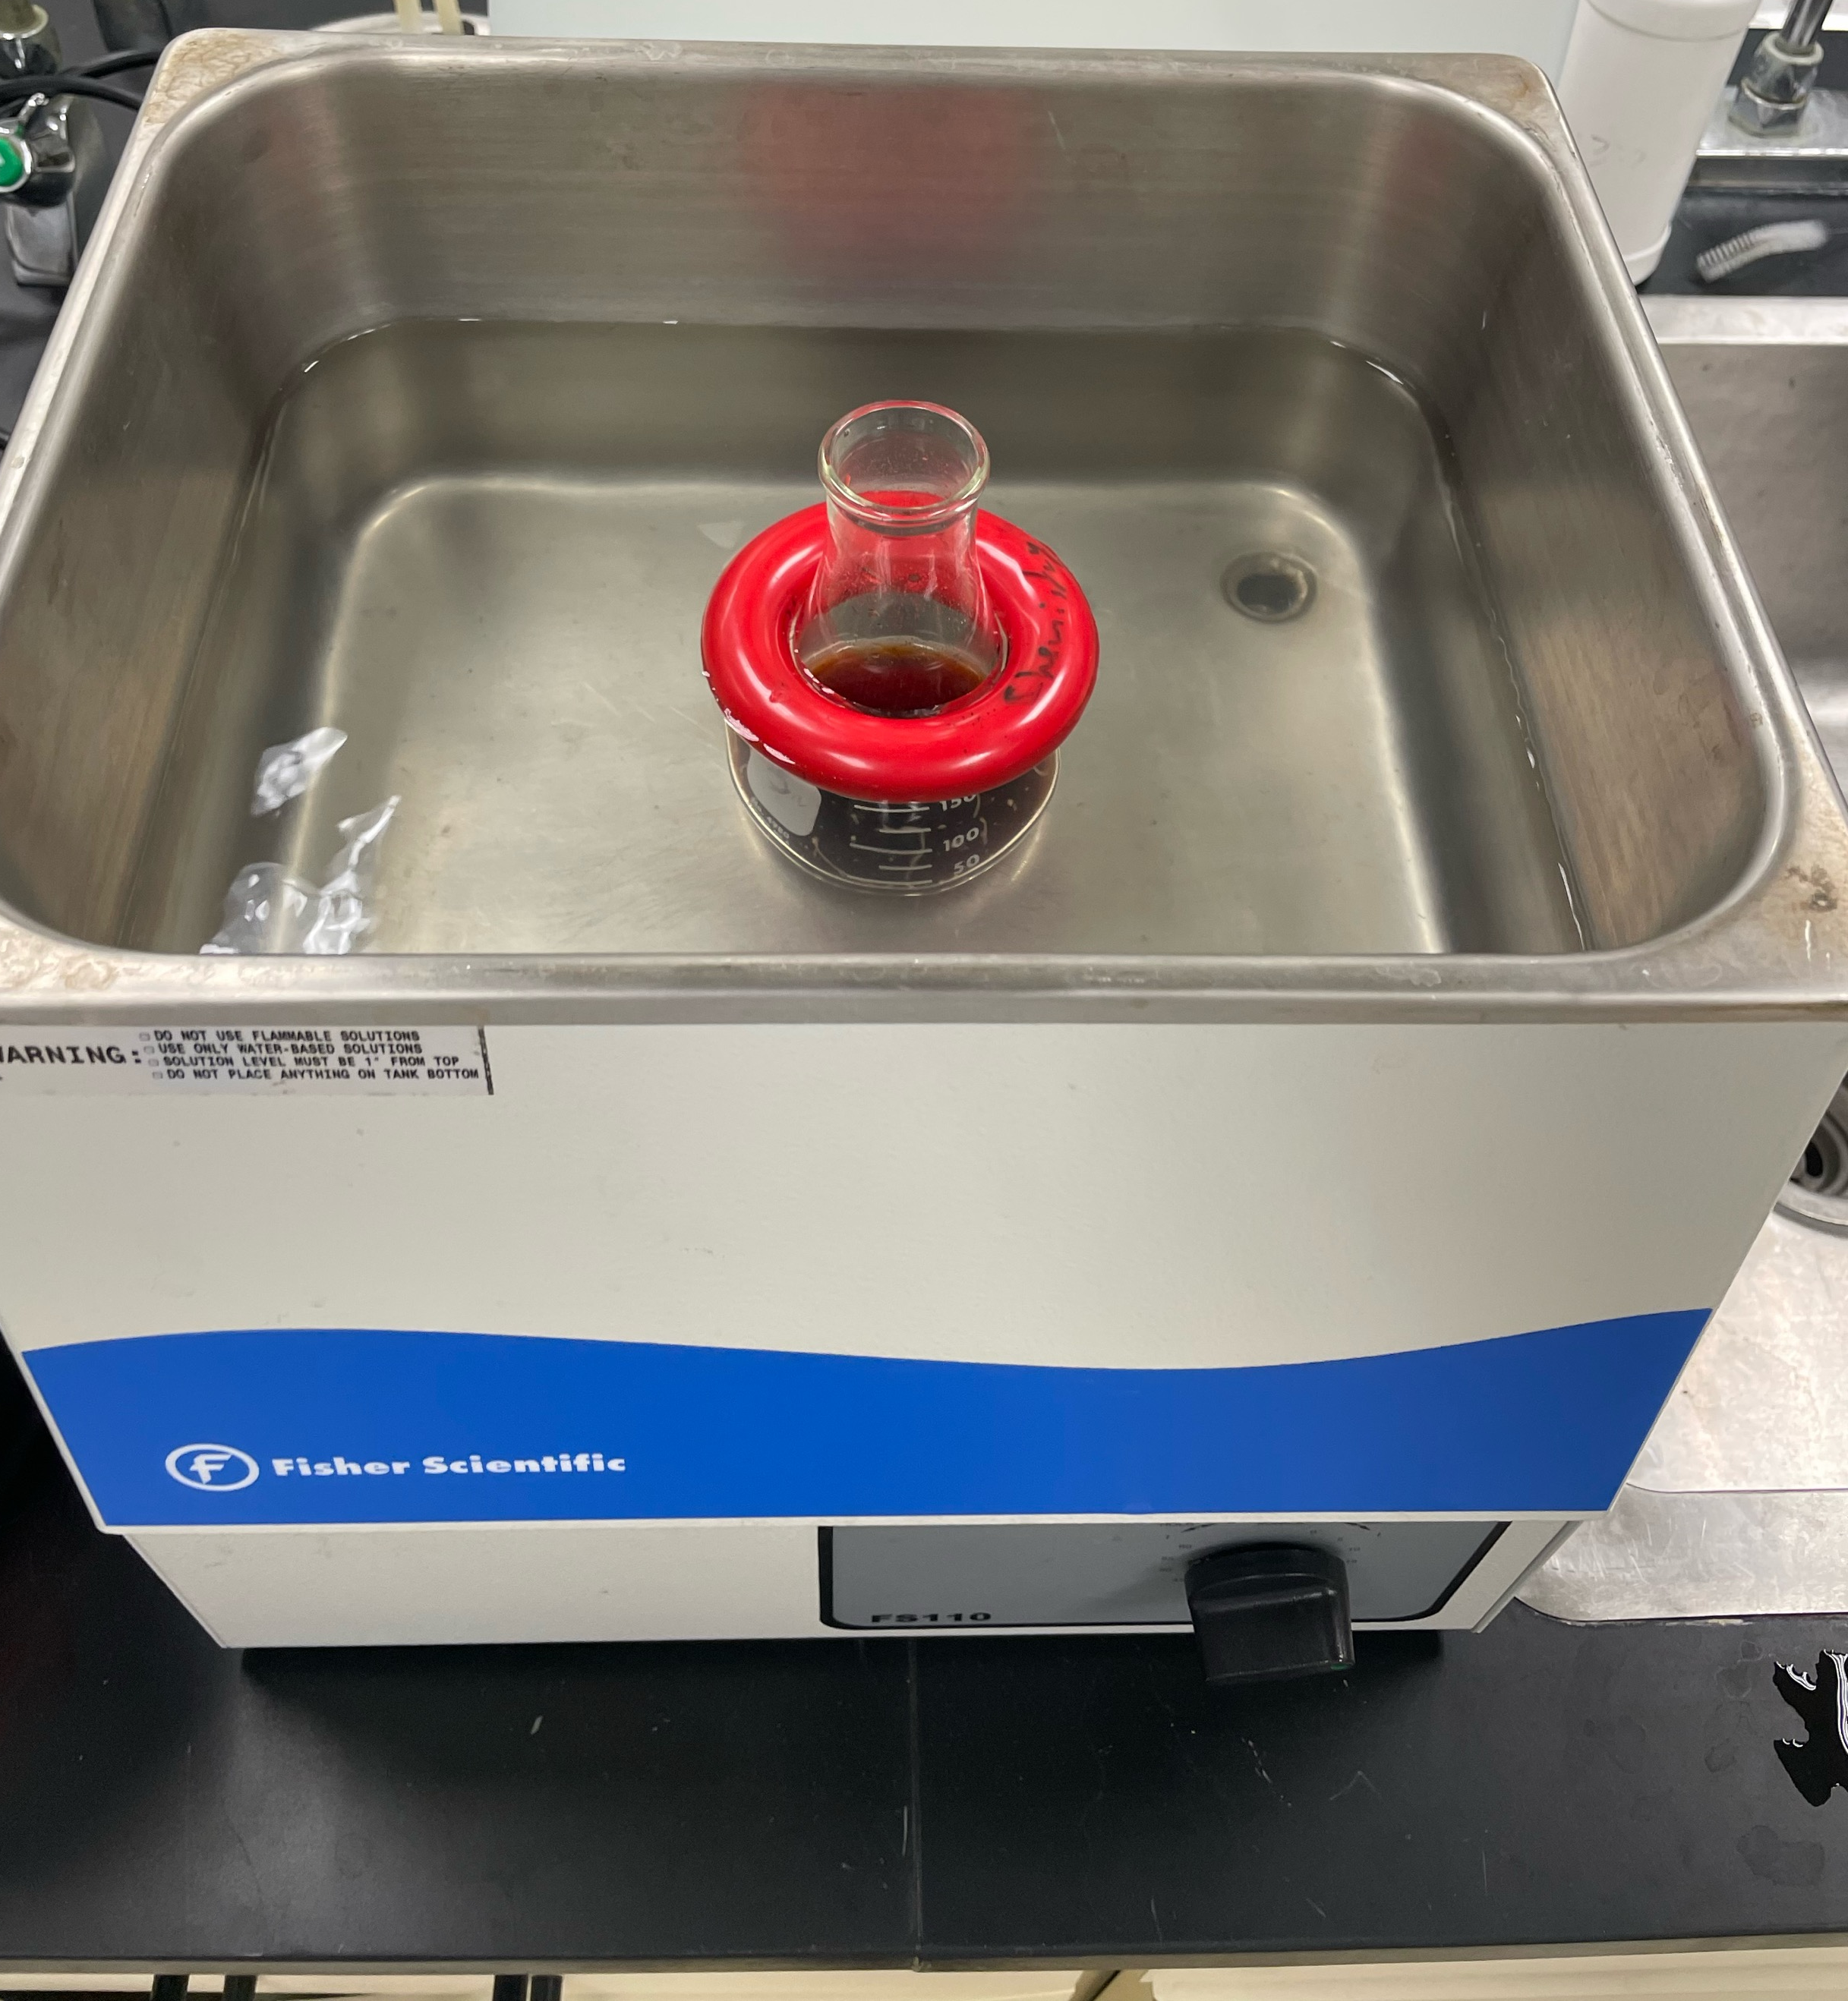
Real Sample Prep
Notes:
A portion of the Monster Energy was poured into a 125mL erlenmyer flask, the sample was then degassed in a sonicator. After 15 minutes of sonicating we filtered it using a 0.2 um luer lock filter directly into an autosampler vial

Slide 7
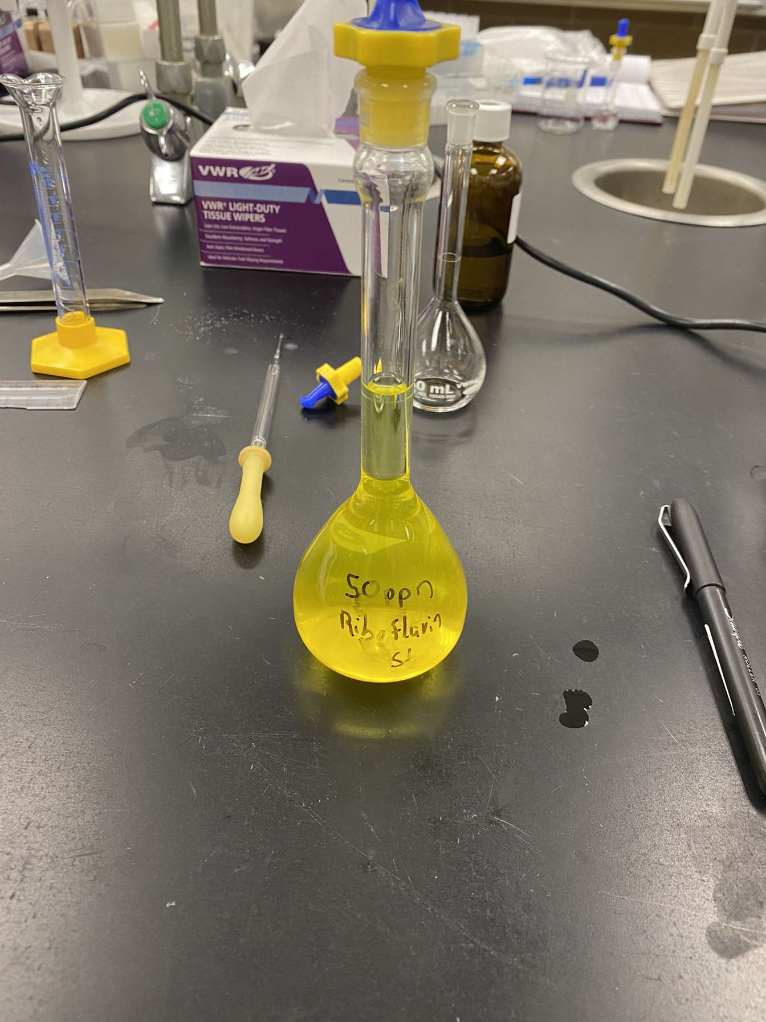
Stock Solutions
54 ppm riboflavin stock solution in 100 mL volumetric flask
Notes:
The riboflavin stock solution was made by weighing out a mass of riboflavin and then dissolving it in a volumetric flask, the flask was filled with HPLC grade methanol. However, the first attempt at making the riboflavin stock solution, the riboflavin did not dissolve and we had a made an orange juice looking solution but it was very toxic. On the second try the flask was filled halfway and shaken vigorously until it was certain that the solution was no longer cloudy. Once the solution was clear then it was made to volume using the HPLC grade methanol.
The caffeine stock solution on the other hand was much more simple, it was given to us. Thank you Michelle!

Slide 8
Creating Caffeine Standards
 | Concentration Caffeine | Volume Stock solution used | RT | Peak Area | Peak Height
 | (ppm) | (uL) | (min) | (mAU*s) | (mAU)
Blank | 0.0 | 0 | - | 0 | 0
Standard 1 | 250 | 1249.0 | 2.599 | 7339.916020 | 1106.75879
Standard 2 | 30.x10¹ | 1499.0 | 2.596 | 9300.900390 | 1335.48743
Standard 3 | 350 | 1748.0 | 2.594 | 10894.300000 | 1504.44092
Standard 4 | 40.x10¹ | 1998.0 | 2.589 | 12361.200000 | 1642.1908
Standard 5 | 450 | 2248.0 | 2.615 | 14033.100000 | 1769.52966
Created using 100-1000 uL micropipettes into 5.0 mL volumetric flasks
Notes:
Riboflavin Concentrations were made such that the expected value would lie within the middle of the calibration curve.
Caffeine Concentrations were made such that we would be able to use the same autosampler vial without having to dilute.

Slide 9
Creating Riboflavin Standards
 | Concentration Riboflavin (ppm) | Volume Stock Solution used (uL)
Blank | 0.0 | 0
Standard 1 | 2.0 | 185.0
Standard 2 | 4.0 | 370.0
Standard 3 | 6.0 | 556.0
Standard 4 | 8.0 | 741.0
Standard 5 | 10 | 926.0
Created using 100-1000 uL micropipettes into 5.0 mL volumetric flasks

Slide 10
Data and results
Notes:
Calibration curve for the 5 caffeine standards and a blank. No duplicates were run using the standards.

Slide 11
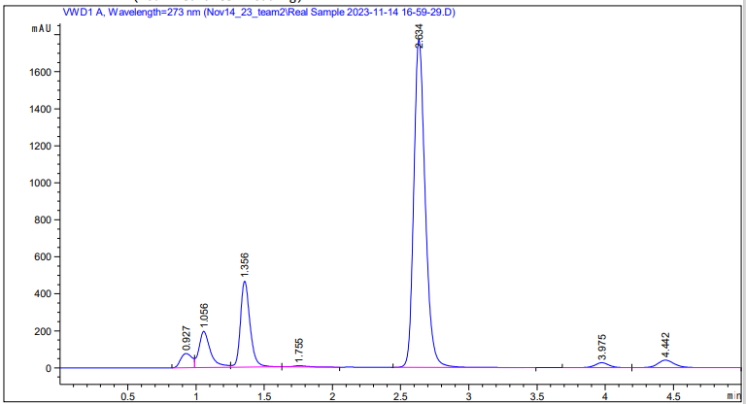
Data and Results
Caffeine concentration determined to be 335 ppm
Caffeine contented listed to be 351. ppm
Notes:
Here is an example of one of our real sample runs. The peak at 2.634 was identified as caffeine by comparing the retention times of the standards. The real sample was run in duplicate and their average calculated concentration is presented. Other peaks were not identified within the chromatogram and can be included in the future work.
Caffeine concentration was determined by interpolating the caffeine standard calibration curve using peak area measurements
Caffeine on the can was listed at 166 mg and the can had a volume of 0.473L so we were easily able to solve for the concentration.

Slide 12
Challenges
Riboflavin stock solution preparation
200ppm not dissolving
Riboflavin detection
No significant peaks
Notes:
Riboflavin was not dissolving in the methanol when we attempted to make a 200ppm stock solution. Despite sonicating and waiting. So, to remedy this we decided to lower the concentration down to 54ppm and that yielded a successful dissolving
When attempting to detect riboflavin, no peaks were found using the 20:80 mix (acetonitrile:buffer) and 20min run time. So we attempted to change to 40:60 split in hopes of our polar solvent retaining the solute better and extending the run time to 30 minutes. This also did nothing

Slide 13
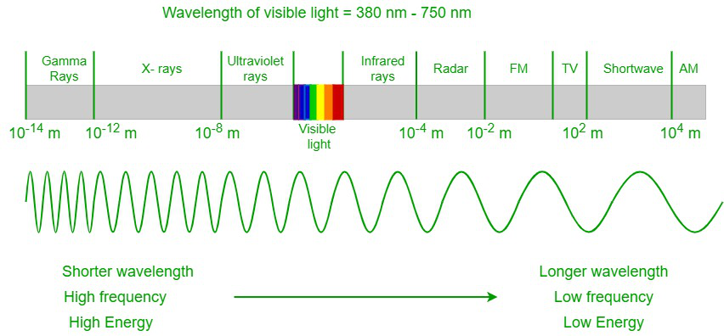
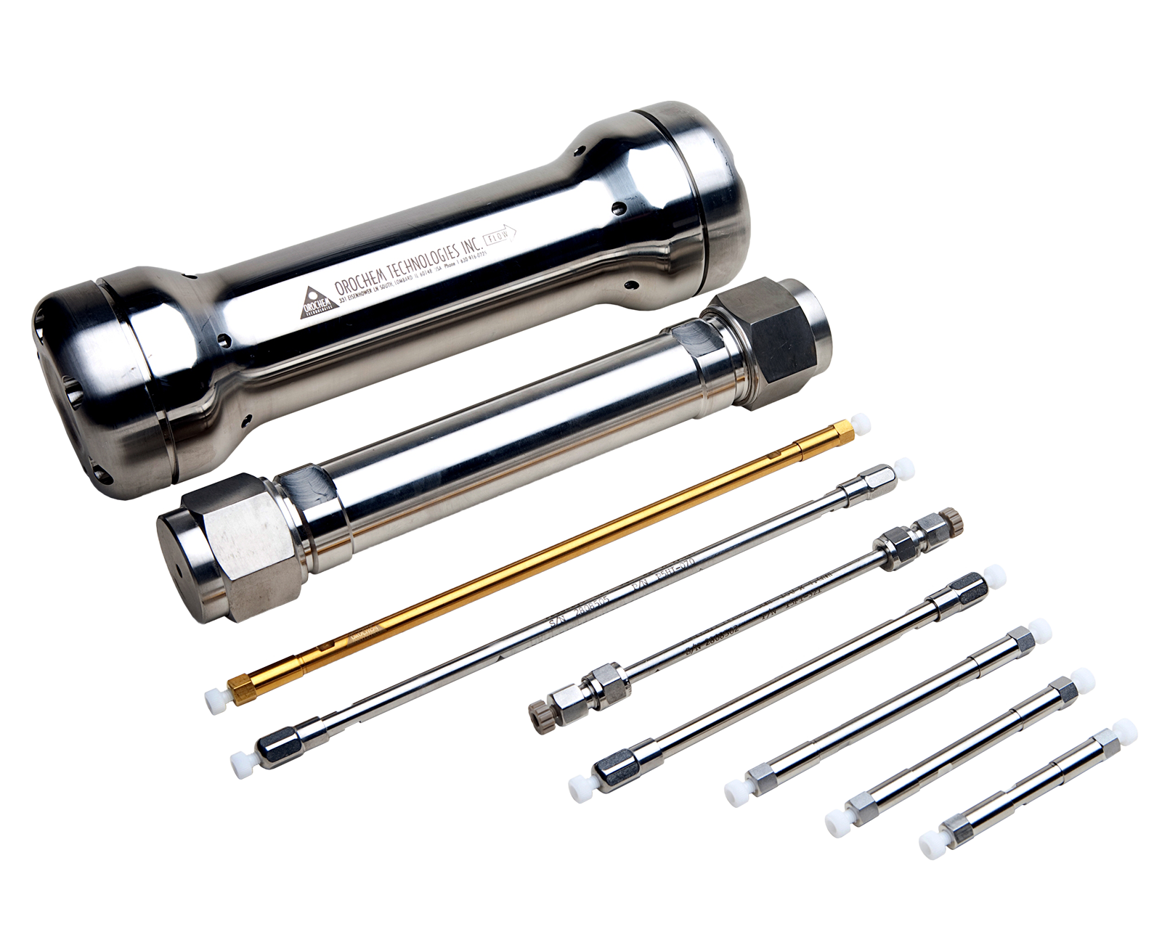
Lessons
Relearned buffer solution preparation
Column and Wavelength matters
Notes:
Given that we followed the literature procedure and setup (except different column) we can safely assume that the column plays a big part. This also means that the suitable wavelength for detection may have been different for our column and alternate parameters

Slide 14
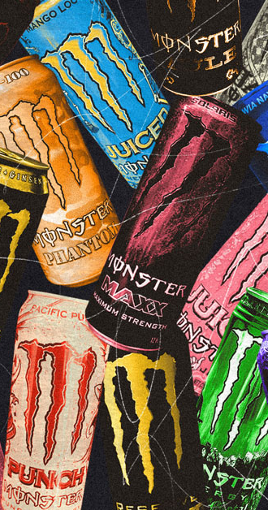
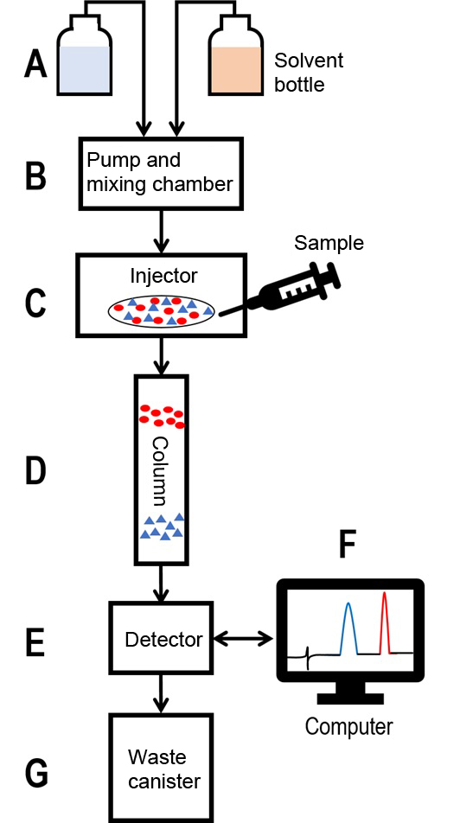
Future Work
Parameters
Multiple cans, multiple flavours
Notes:
If we had more time, it would be nice to dial in the parameters that would detect riboflavin. This would mean alteriung wavelegngth, time, and most importantly, column
We also would like to try different flavours and multiple of the same can. To see if the caffeine concentration differs from flavour to flavour or can to can

Slide 15


Conclusion
Riboflavin
Caffeine
Notes:
Overall, no riboflavin was detected and caffeine was found to be 335ppm which is slightly below the can’s stated concentration of 351ppm

Slide 16
References
Brewer, S. Chemistry 3120 Instrumental Analysis Laboratory Manual; Thompson Rivers University: Kamloops, BC, 2023.
Health Canada, Caffeine in foods, Government of Canada, 2022. https://www.canada.ca/en/health-canada/services/food-nutrition/food-safety/foodadditives/caffeine-foods.html (accessed November 20, 2023)
Marti-Andres, P. L.; Escuder-Gila, L. Y.; Martin-Biosca, S. Y.; Sagrado, S.; Medina-Hernandez, M. J. Simultaneous Determination of Pyridoxine and Riboflavin in Energy Drinks by High-Performance Liquid Chromatography with Fluorescence Detection. J. Chem. Educ. 2015, 92, 5, 903–906. https://doi.org/10.1021/ed500544h
Harvard T. H. Chan School of Public Health, Vitamin B2 The Nutrition Source. 2023. https://www.hsph.harvard.edu/nutritionsource/riboflavin-vitamin-b2/#:~:text=RDA%3A%20The%20Recommended%20Dietary%20Allowance,and%201.6%20mg%20daily%2C%20respectively. (Accessed November 20, 2023)

