Slide 1
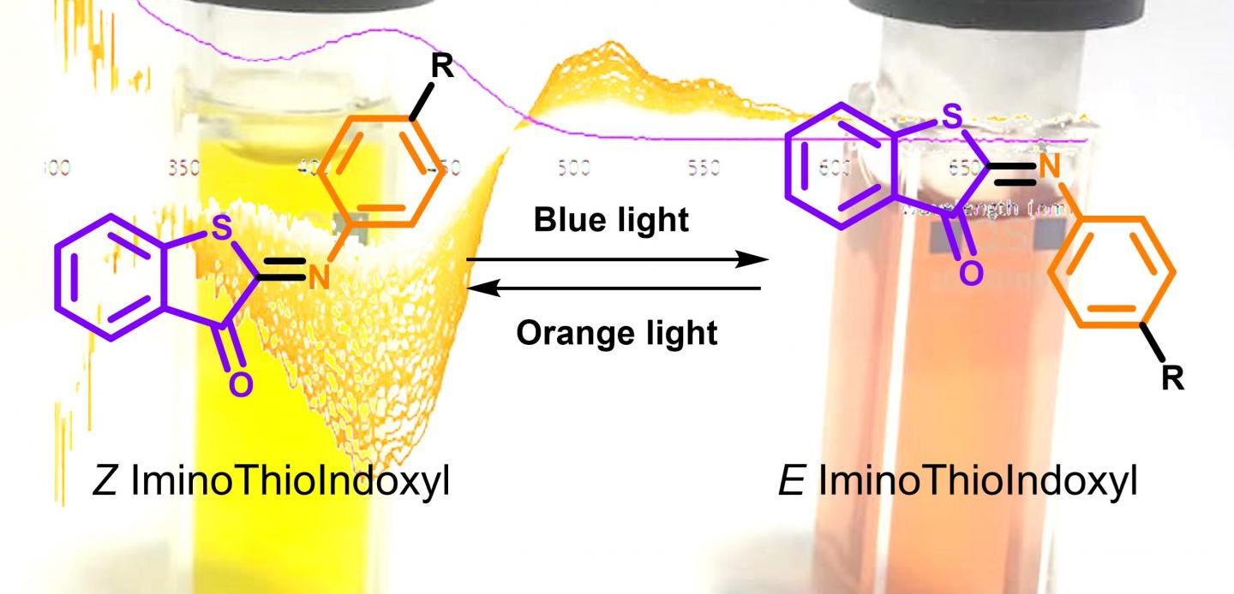
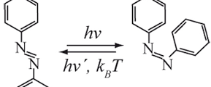
Molecular Switches and Current Resaearch Topics
By: Mason Swanton
Notes:
Summary:
In this presentation I’m going to introduce the topic of molecular switches, a little about their history, popular uses today, and then I will dive into my article of choice.

Slide 2
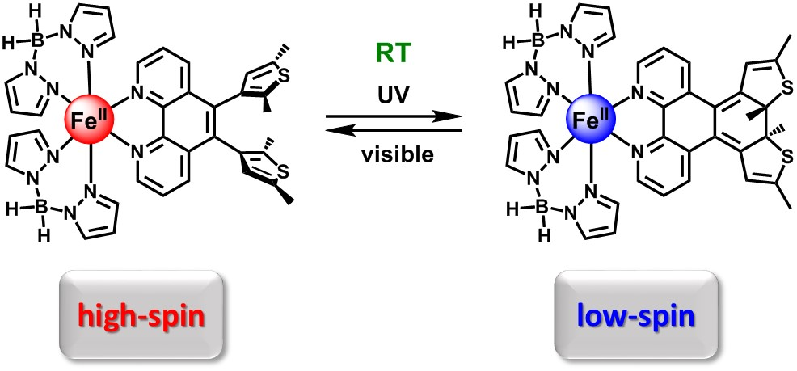
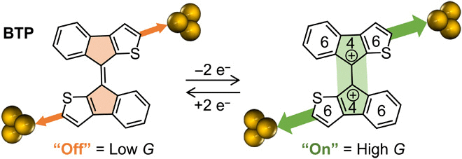
About
What are molecular switches?
What types of molecular switches are there?
Notes:
What are molecular switches?
Molecular switches are molecules that can shift between two states in a controlled manner. This can be triggered by temperature, light, current, etc

Slide 3
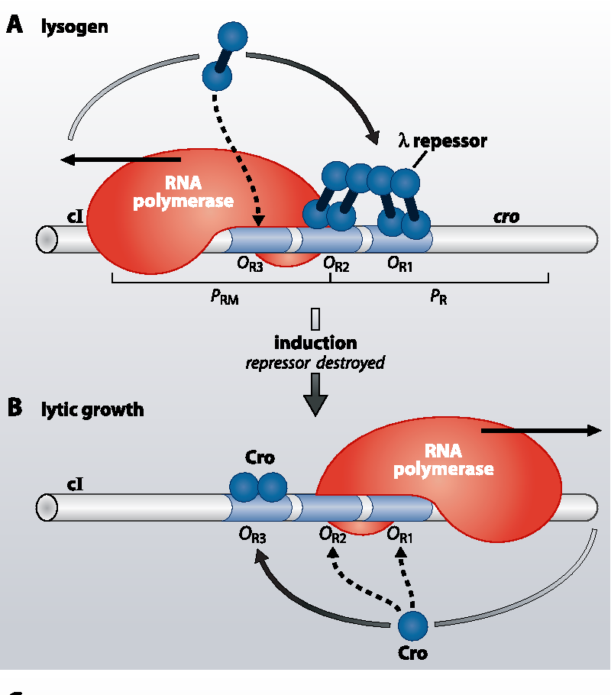

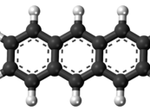
History
In 1970s the use of a photo-switch in crown ether
Origins of the term “molecular switch” came from the 1980s
Notes:
Molecular switches have been in chemistry since the start, even if the chemists didn’t know this. While the term “molecular switch” originally came from the 1980s regarding biological signal transmission.¹ (used in a paper in 1981 about lamba repressor) It has since been widely adopted for chemistry as a general term describing a molecule that flips between two states.
A notable discovery for molecular switches that link to another topic to be discussed in our presentations came in the 1970s, when a researcher Jean-Pierre gave important contributions by using phot-switches to induce switching of crown ethers using anthracenes
Since then, other types of molecular switches have been documented and their uses expanded.

Slide 4
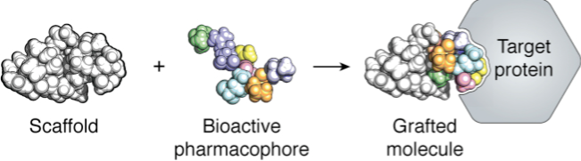
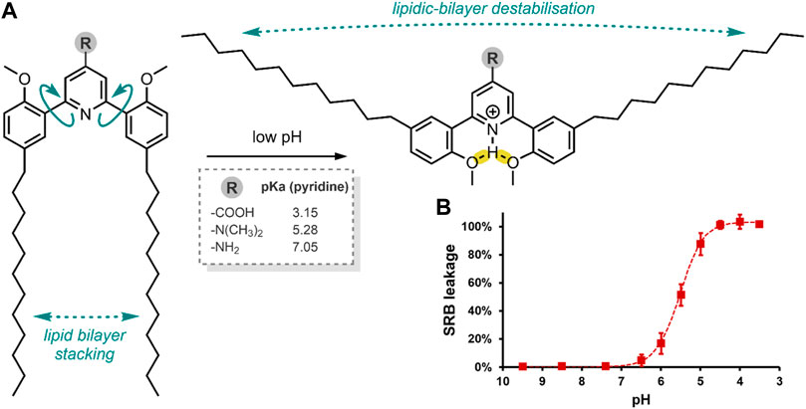
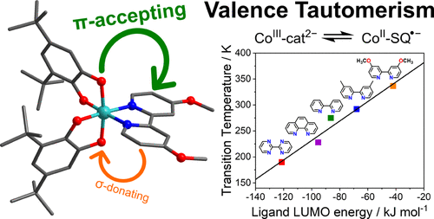
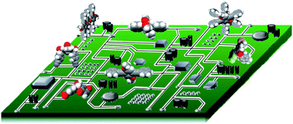
Current Uses
Organic
Inorganic
Drug release control
Anticancer therapies
Molecular electronics
Molecular grafting
Theoretical calculations
Notes:
Uses
A popular topic today for organic molecular switches is their use in drug-release control to induce precise dosages at specific sites. This type of drug administration would be highly useful, most notably, in anticancer therapies.²
On the inorganic side of things, topics like
molecular grafting – Using a molecular scaffold to construct new molecules
theoretical calculations for molecular switches are being researched – Hopes to identify molecular switches before a wet lab needs to be performed

Slide 5
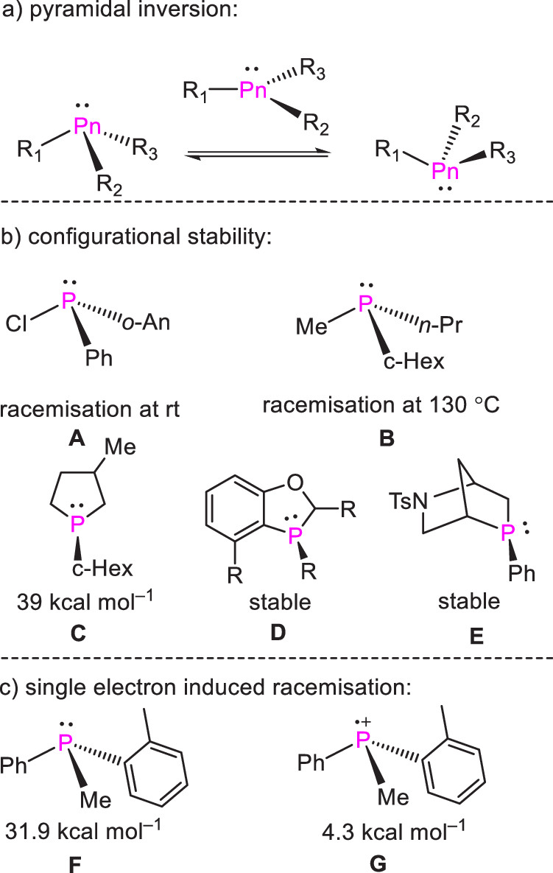
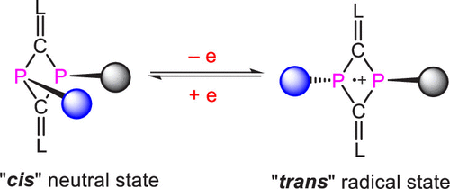
Article Topic
Pyramidal inversion of diphosphetanes
Possible building blocks for supramolecular chemistry?
2013 paper showed single electron removal reduced barrier
Notes:
The research article I have chosen is about pyramidal inversion. Pyramidal inversion is a fluxional process that effects the interconversion of two conformations of a pyramidal molecule.³
In 2013, research was done that showed that removing one electron reduced the inversion barrier of phosphine from 31.9 kcal/mol down to 4.3 kcal/mol. However, the redox-triggered inversion was tricky to characterize using the acyclic achiral phosphines that were used in that experiment. Single-electron-induced pyramidal conversion of cyclic phosphines has not been described.
In 2017, another group of researchers described the synthesis of ligated dicarbondiphosphide. The researchers of the article I am presenting believed this synthesis would be a good starting point for trivalent cyclic phosphine that could be used to characterize the pyramidal inversion

Slide 6
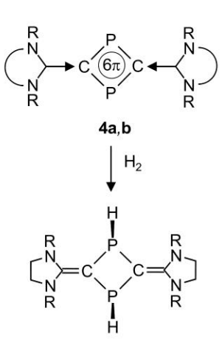
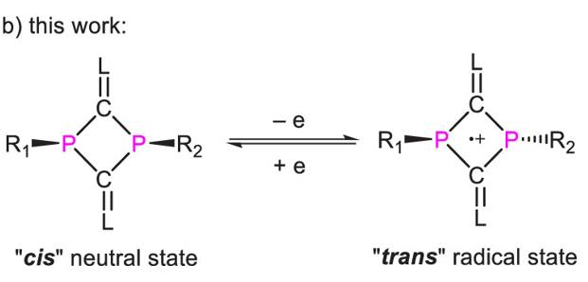
What Did the Article Do?
Used both 2013 and 2017 articles as a base
Previous paper found pyramidal inversion was not observed
Stereoselective synthesis of stable cis-1,3-diphosphetane can switch due to single electron transfer
Notes:
Using work from 2013 and 2017 as a background, the research team showed that a highly stereoselective synthesis of stable cis-1,3-diphosphetanes can have its pyramidal inversion reversibly triggered via single-electron transfer to corresponding trans-1,3-diphosphetanes radical cations.

Slide 7
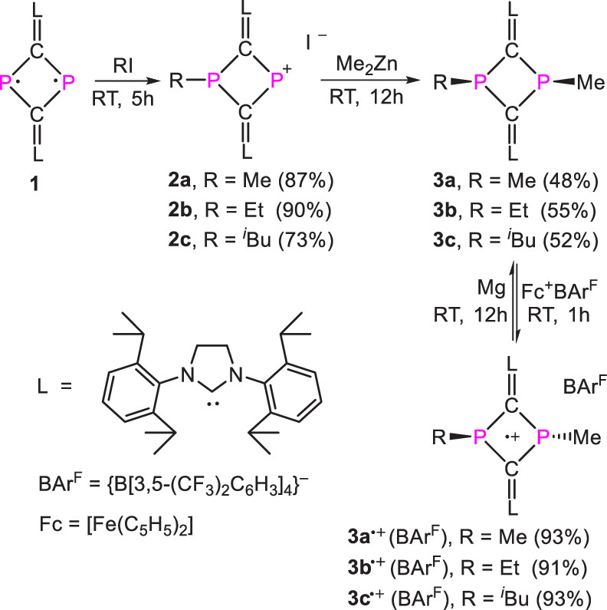
Experimental
Synthesized products 3a/b/c and characterized using ³¹P NMR
Converted 3a/3b to trans using toluene + heat
This switch was short lived
Finally, removal of one electron
Notes:
The team used the above synthesis to work from the initial chemical 1 to the products seen in part 3 (a/b/c) each of the products from each step were characterized using proton-decoupled ³¹P NMR as well as X-ray diffraction if needed. Once the products 3a/3b were obtained, they then proceeded to convert them from cis to trans via heating a toluene solution and then confirming the change using ³¹P NMR. It was observed that 3a and 3b both reverted to cis forms when left to sit in room temp toluene for a few days. Cis-3c, however, did not change to trans-3c after toluene solution heating suggesting that steric play a role. Additionally, this proved that cis conformations were more thermodynamically stable than trans conformations.
Finally, upon removing one electron via the conditions in the scheme, the radical cation trans conformations were unlocked.

Slide 8
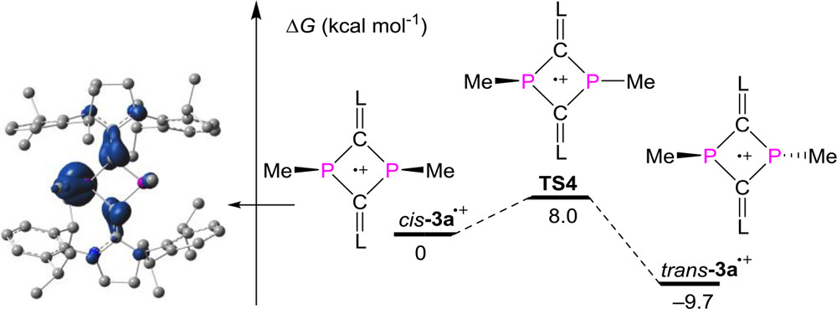
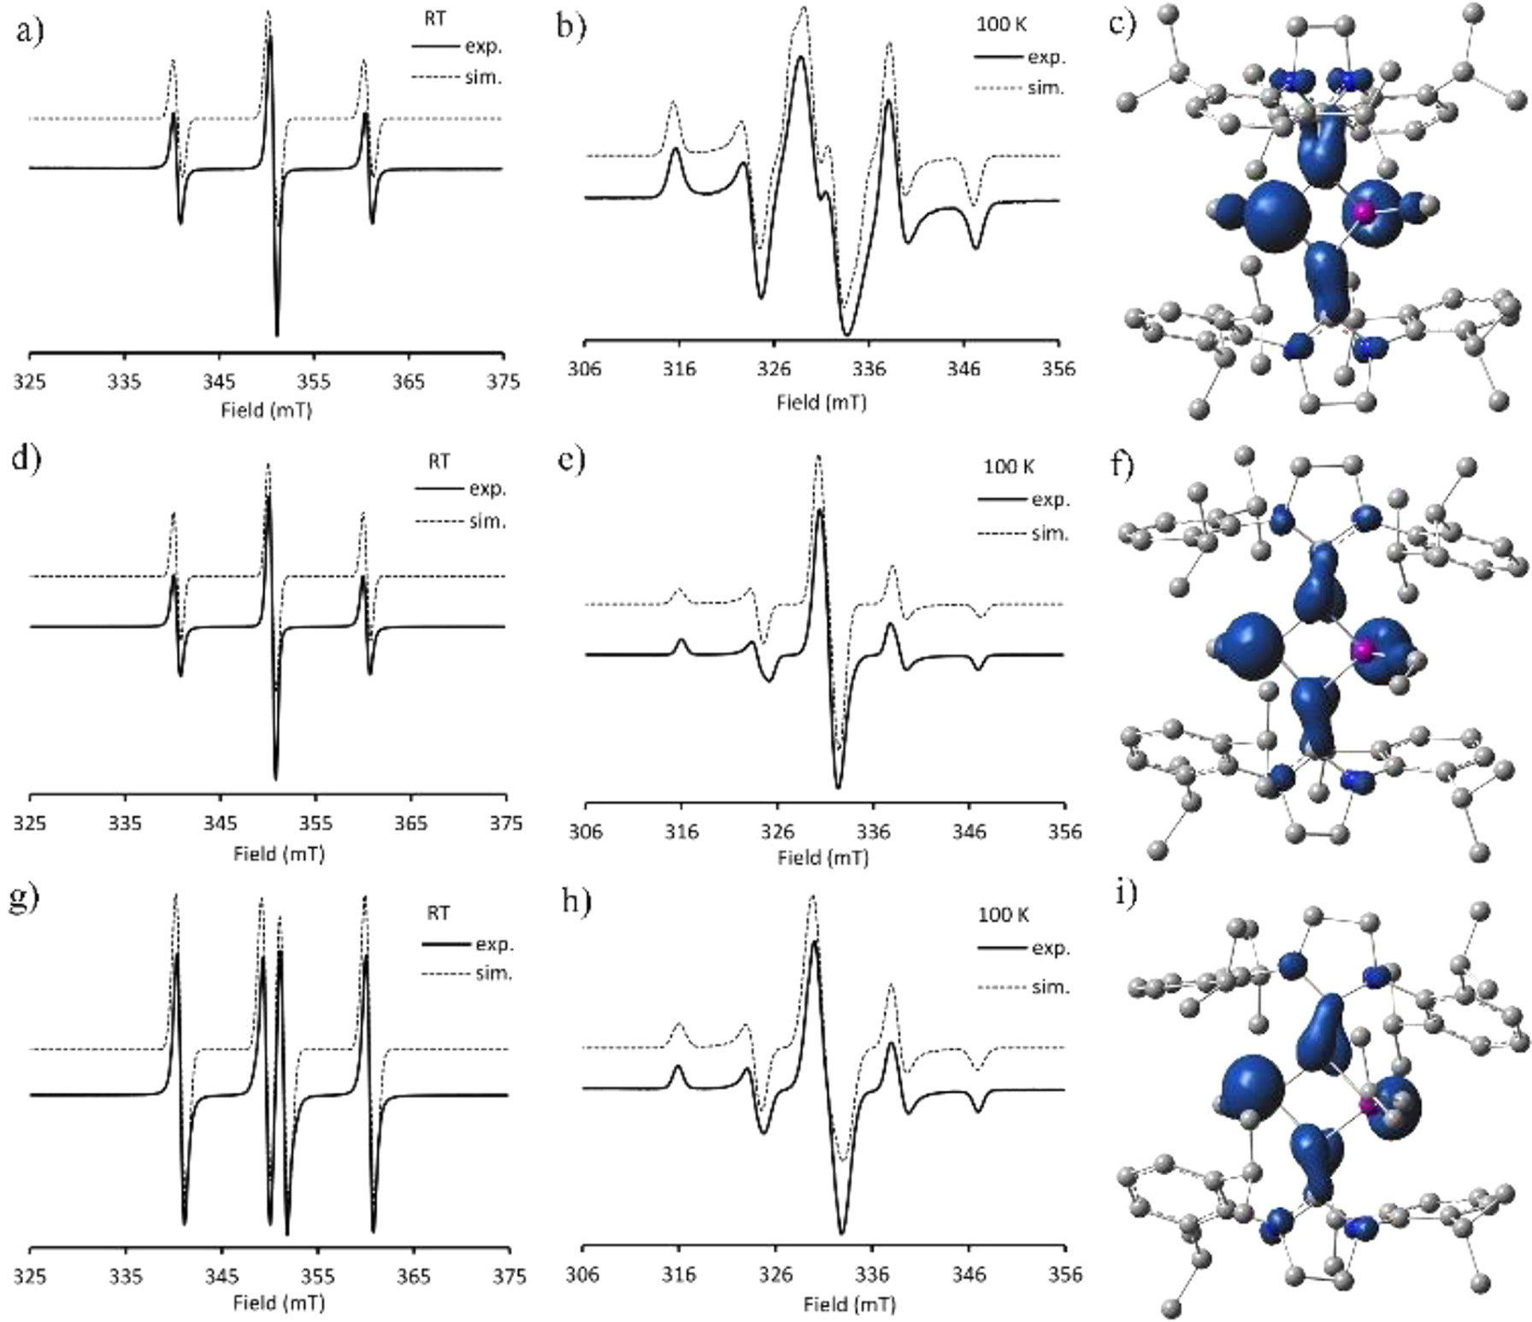
Findings
Products were characterized via EPR at room temp
DFT calculations showed trans radical to be more stable
Notes:
The 3a+ and 3b+ radicals were characterized using EPR at room temp.
DFT calculations were performed and showed that the cis radical cation versions of 3a was thermodynamically less stable than the trans radical cation.
Using work from 2013 and 2017 as a background, the research team showed that a highly stereoselective synthesis of stable cis-1,3-diphosphenates can have its pyramidal inversion reversibly triggered via single-electron transfer to corresponding trans-1,3-diphosphenates radical cations.

Slide 9
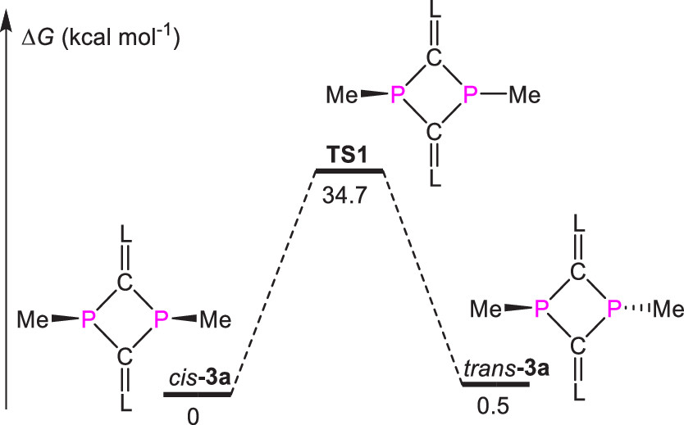
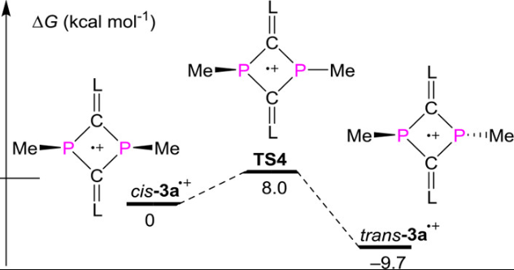
Conclusions
Three Main Conclusions:
Cis-1,3-diphosphenates are sterically favoured
Trans-1,3-disphosphenates are electronically favoured
Removal of one electron from cis significantly decreases P-center inversion barrier
Experiments confirm discovery of a switchable cyclic phosphine molecule
Future:
Describes a redox-triggered configurational switch for small rings
Application for electrical switches and supramolecular chemistry
Strong binding/efficient coupling between building blocks
Radical/supramolecular cages
Notes:
Team confirmed that the normal (non-radical) conformations highly favoured the cis-configuration
upon removal of one electron, the conformation would shift to the trans-conformation.
This research represents the first examples of 1,3-diphosphetane-based radical cations and establishes a redox triggered configurational switch for small ring systems. The researchers hope that this work can become a playground for future molecule switch work and supramolecular chemistry. Additionally, they believe the results could show application for planar four membered rings for electrically fueled molecular switches.

Slide 10
References
Introduction to the Themed Issue Dedicated to Jean-Pierre Desvergne. Photochem. Photobiol. Sci. 2012, 11 (11), 1611–1612. https://doi.org/10.1039/c2pp90037h.
Bresien, J.; Kröger-Badge, T.; Lochbrunner, S.; Michalik, D.; Müller, H.; Schulz, A.; Zander, E. A Chemical Reaction Controlled by Light-Activated Molecular Switches Based on Hetero-Cyclopentanediyls. Chemical Science 2019, 10 (12), 3486–3493. https://doi.org/10.1039/c8sc04893b
Fitzmaurice, O.; Bartkowski, M.; Giordani, S. Molecular Switches—Tools for Imparting Control in Drug Delivery Systems. Frontiers in Chemistry 2022, 10. https://doi.org/10.3389/fchem.2022.859450
Fuentes, N.; Martín-Lasanta, A.; Álvarez de Cienfuegos, L.; Ribagorda, M.; Parra, A.; Cuerva, J. M. Organic-Based Molecular Switches for Molecular Electronics. Nanoscale 2011, 3 (10), 4003. https://doi.org/10.1039/c1nr10536a.
Janetzki, J. T.; Zahra, F.; Gable, R. W.; Wasinee Phonsri; Murray, K. S.; Lars Goerigk; Boskovic, C. A Convenient DFT-Based Strategy for Predicting Transition Temperatures of Valence Tautomeric Molecular Switches. Inorganic Chemistry 2021, 60 (18), 14475–14487. https://doi.org/10.1021/acs.inorgchem.1c02273.
Chen, X.; Hu, C.; Zhang, X.; Liu, S.; Mei, Y.; Hu, G.; Liu, L. L.; Li, Z.; Su, C.-Y. Reversible Stereoisomerization of 1,3-Diphosphetane Frameworks Revealed by a Single-Electron Redox Approach. Inorganic Chemistry 2021. https://doi.org/10.1021/acs.inorgchem.1c00064.
Li, Z.; Chen, X.; Andrada, D. M.; Frenking, G.; Benkö, Z.; Li, Y.; Harmer, J. R.; Su, C.-Y.; Grützmacher, H. (L)₂C₂P₂: Dicarbondiphosphide Stabilized by N-Heterocyclic Carbenes or Cyclic Diamido Carbenes. Angew. Chem., Int. Ed. 2017, 56, 5744– 5749, DOI: 10.1002/anie.201612247

