Slide 1

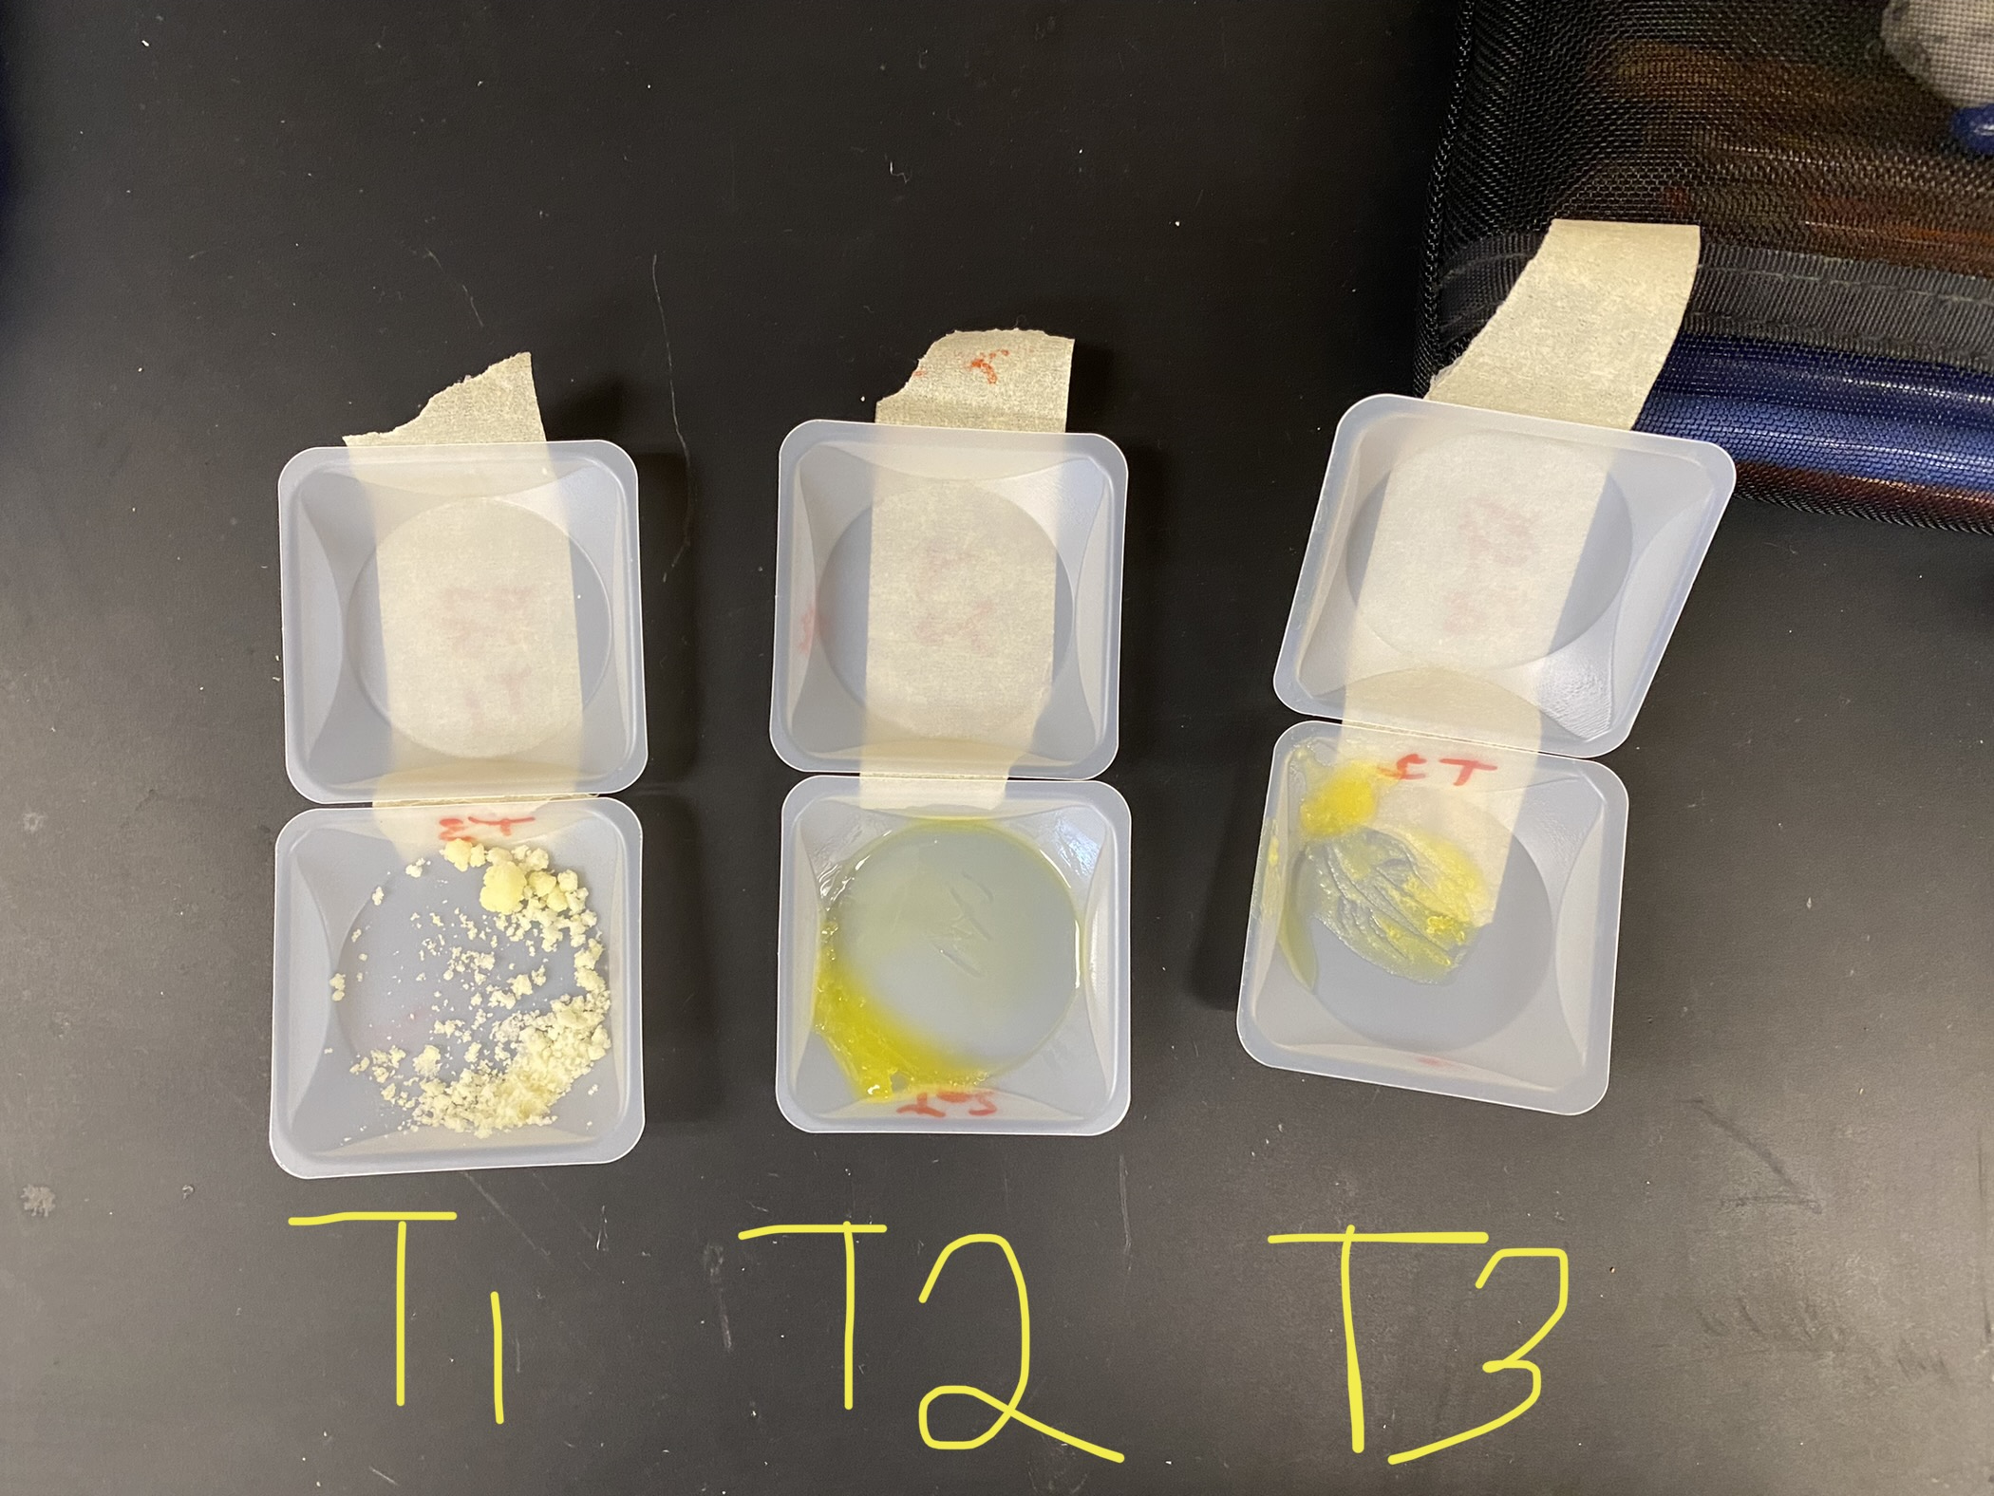
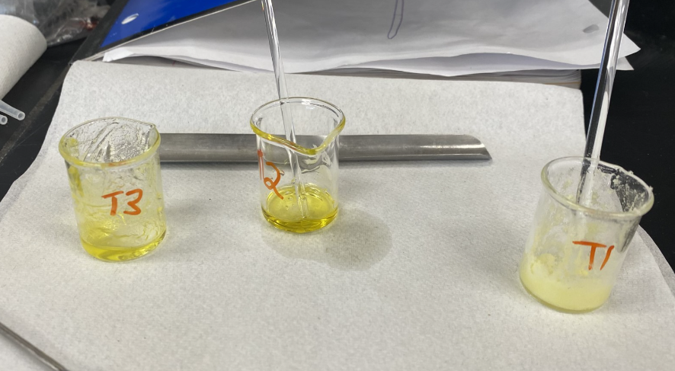
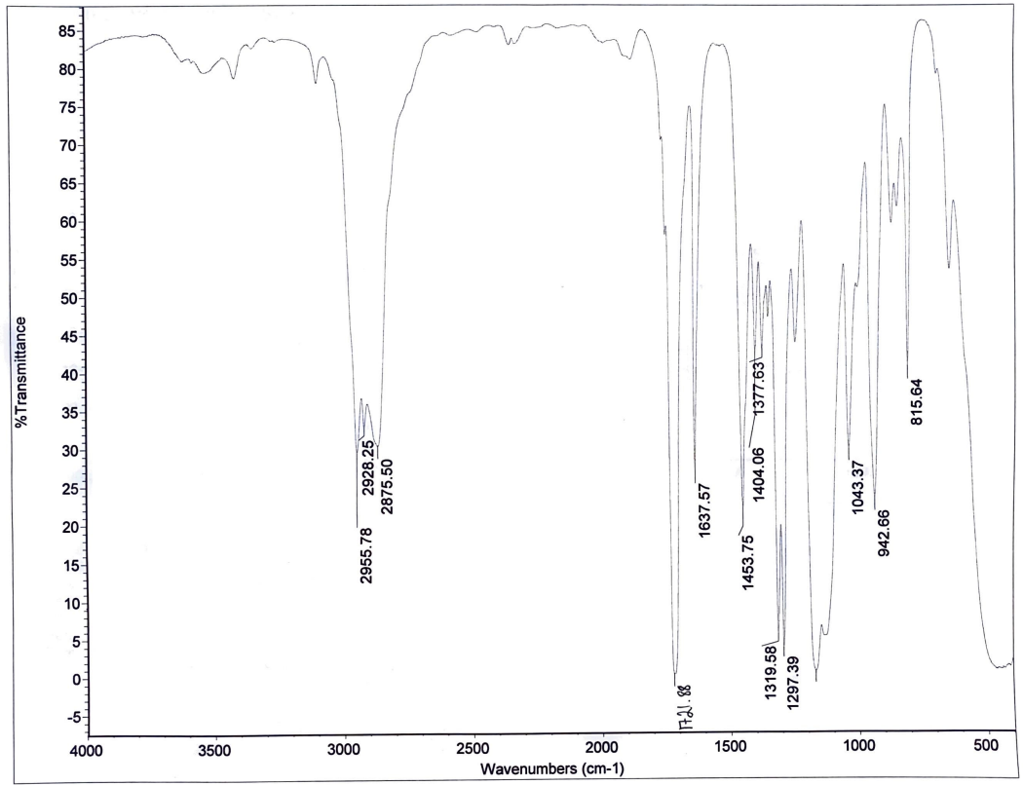
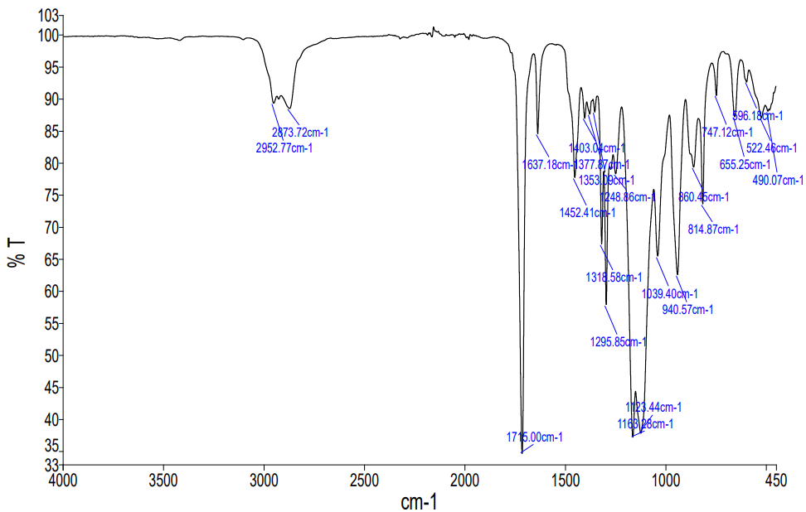
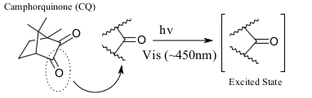
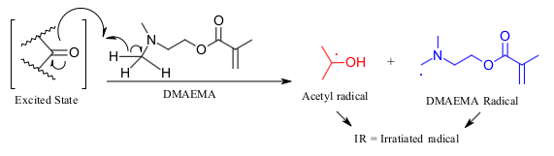
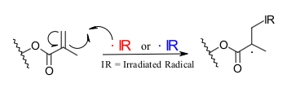
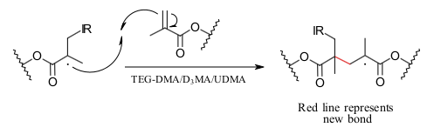
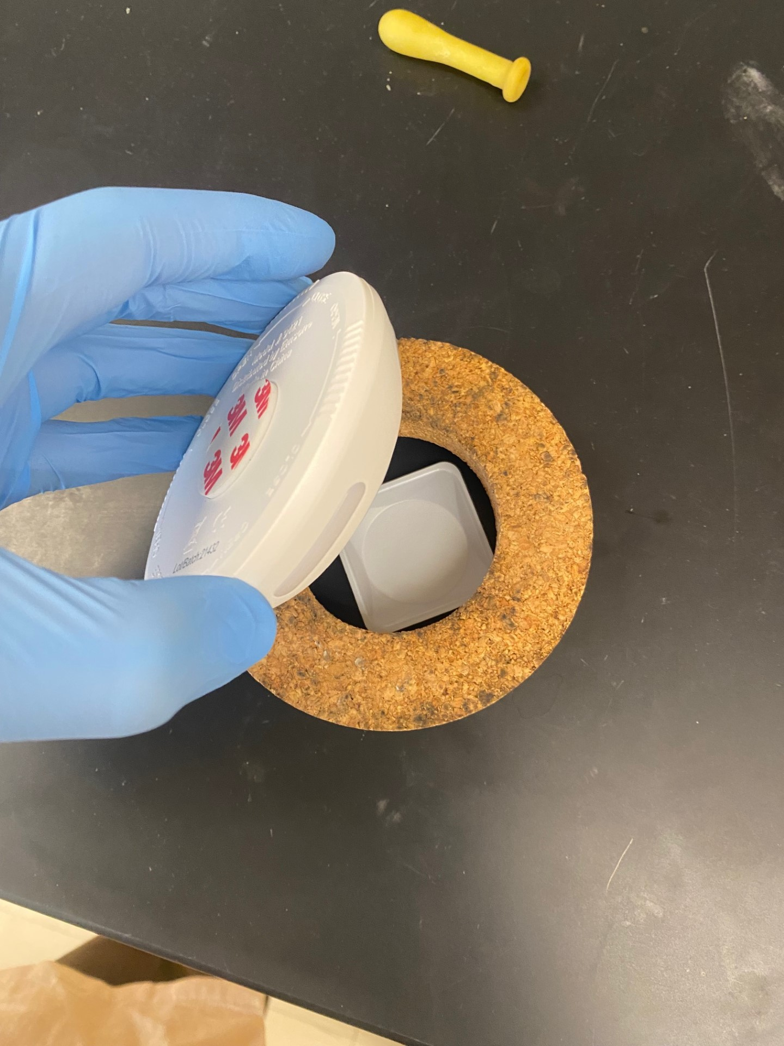
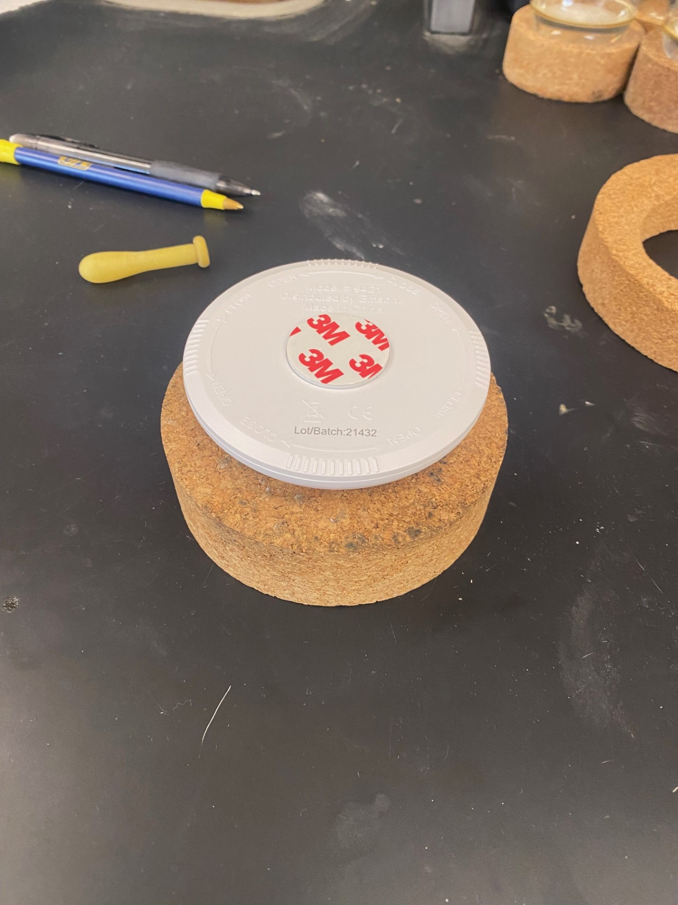
Developing a Light-Activated Organic Polymerization
Laboratory Activity with Applications to Dentistry
Poster by: Mason Swanton
TRU Supervisor: Dr. Bruno Cinel TRU Co-supervisor: Dr. Jess Allingham
Research Goal
Procedure
Results
Investigate polymerization reactions used in the making of dental polymers to develop a future chemistry laboratory activity linking curriculum content to the real world.
Put on PPE and bring chemicals to analytical balance
Carefully weigh out 1.0000 g of the given TEG-DMA into 10mL beaker
Weigh out 10.00mg or 1.0% weight of DMA by weight of CQ into separate 10mL beaker
In the same beaker as the CQ, weigh out 2.0% DMAEMA or 20.00 mg
The co-initiator should be in a 2:1 ratio with photo-initiator
Mix the CQ and DMA-EMA thoroughly or until homogeneous
Note that some clumps may be seen, but these should dissolve
Weigh out around 45% by weight filler (0.4500 g)
Add the CQ and DMAEMA mixture to the DMA beaker and stir with stir rod until mixed well
Once CQ and DMAEMA are added and mixed to the DMA beaker, add 0.4500 g filler of silica gel 200-400 mesh
Part 2
After adding filler (optional), and the mixture was thoroughly mixed, then poured onto a small weigh boat
Keep majority of the mixture in one corner to create some depth
Carefully place weigh boat, with mixture, into the center of the cork circle (keeping it at an angle as in Figure 4)
Cover the cork with the light and begin to cure on either blue (~450 nm) or red (~650 nm) light for around 5 minutes
The first three initial trials followed our experimental procedure with varying filler amounts. T1 used 45%, T2 used 0% filler and T3 had the literature reported value of 75%.¹
Trial 3 was identified to be the best mixture and therefore was our baseline mixture for testing other factors.
Figure 6. Resulting IR from curing for 5 minutes using red light (left) or blue light (right). The IR was taken from the TEG-DMA sample without filler
Note the two drops in peak size for both the peaks at ~2900 cm⁻¹ and ~1637 cm⁻¹. The 1637 cm⁻¹ could represent the loss of a C=C as seen in Figure 3. While he drop in peak size around 2900 cm⁻¹ is possibly due to polarity/dipole change after curing.
T1
T2
T3
Introduction
Dental fillings are made up using two methacrylate monomers in combination with an interchangeable bridge, like TEG (triethylene glycol) or BisA to form polymer chains (see Figures 1 and 2).
These, or similar, monomers will come together to make the building blocks for the molecule used in this study known as Triethylene glycol dimethylacrylate (TEG-DMA) seen in Figure 2.
Figure 2. TEG-DMA molecule with individual components highlighted in their respective colours
T1
T2
T3
Figure 5. Above we see the before cure and after cure results of our three trials
After curing, the three trials were observed to have various effects:
Trial 1 (45% filler) was the most successful. Best viscosity before curing, and after curing it became a hard solid that neither crumbled nor squished easily.
Trial 2 (no filler) kept its liquid shape but did not seem to cure into a hard solid. Instead, it remained like a firm Jell-O.
Trial 3 became very crumbly and, while somewhat hard, could be crushed and broken down relatively easy.
Figure 1. Monomer building blocks for dental polymers
Background
In the Organic Chemistry 1 course, students are introduced to polymerization along with radical reactions. This, along with the student's knowledge of frequency or wavelength catalyzed reactions (a proposed reaction can be seen in Figure 3) will be used to help students visual the ongoing reaction of this experiment.
1
2
Conclusion
Acknowledgements
I would like to thank Dr. Bruno Cinel for being the main supervisor and providing me with the tools and support for this project. A thank you to my co-supervisor Dr. Jess Allingham as well.
Lastly, I would like to thank Dr. Michael Wentzel for offering guidance and insight into the research he and his team are doing on dental polymers as well. His video was a big help and inspiration.
3
4
A rudimentary composition of dental fillings as well as the polymerization reaction involved with these components was identified and documented
A procedure to make these dental polymers was developed and variations were tested
Testing provided us with knowledge on characteristics of the two DMAs used
Identified the results caused by mixing different amounts of chemicals or fillers
Demonstrated the need for blue light, as well as intensity, for the reaction to cure in a timely manner
Figure 3. Proposed light-activated radical reaction for polymerization
Learning Outcomes
Demonstrate proper use of Personal Protection Equipment (PPE) and safe handling of chemicals
Calculate stoichiometric amounts needed for reactions
Use analytical balances to accurately weigh out reagents
Investigate the effects of different wavelengths on a light activated reaction
Gain experience using FTIR instruments and interpreting spectra
References
1) Chu, T.-M.; Platt, J. Original Research Dental Materials Hani Nassar (A). https://doi.org/10.1590/1807-3107BOR-2016.vol30.0066.
2) Dental Polymer Lab Pre-Lab. Wentzel Lab. Youtube, February 24, 2019. https://www.youtube.com/watch?v=C_tgPi-DRz4&ab_channel=WentzelLab
3) Schneider, L. F. J.; Cavalcante, L. M.; Consani, S.; Ferracane, J. L. Effect of Co-Initiator Ratio on the Polymer Properties of Experimental Resin Composites Formulated with Camphorquinone and Phenyl-Propanedione. Dental Materials 2009, 25 (3), 369–375. https://doi.org/10.1016/j.dental.2008.08.003.
Future Work
Identify how to adapt the procedure to test other dimethacrylates
Further refine the procedure to optimize the mixture amounts
Continue to develop the lab and how products can be tested or identified (force testing, NMR, etc.)
Use procedure to make dental polymers that could then be used to fill 3D printed teeth²
Figure 4. Light and cork stand setup for curing samples

