Slide 1

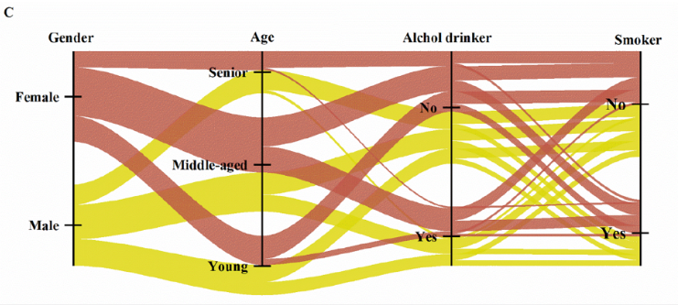
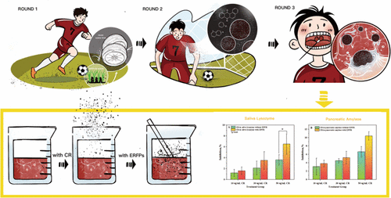
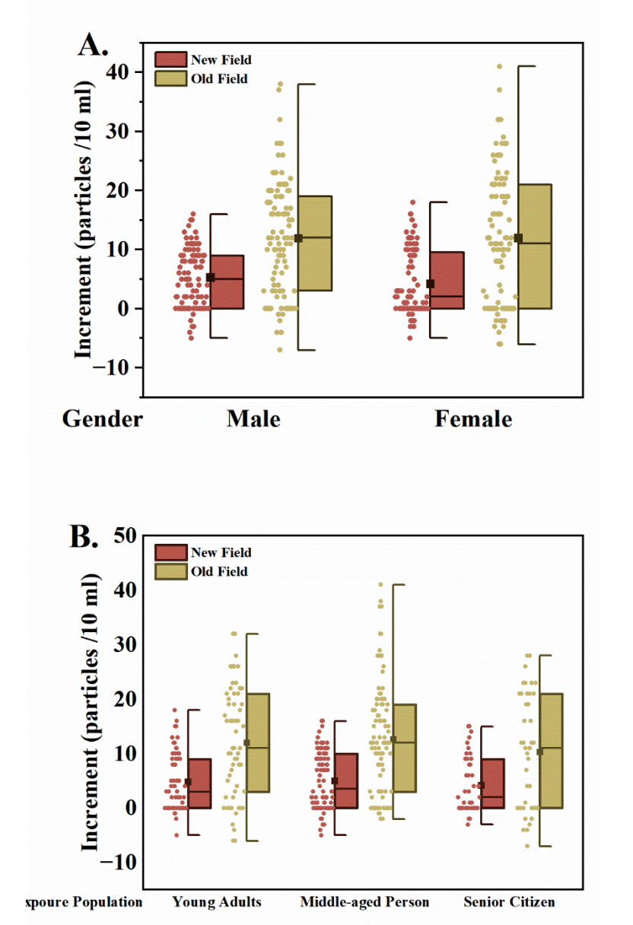
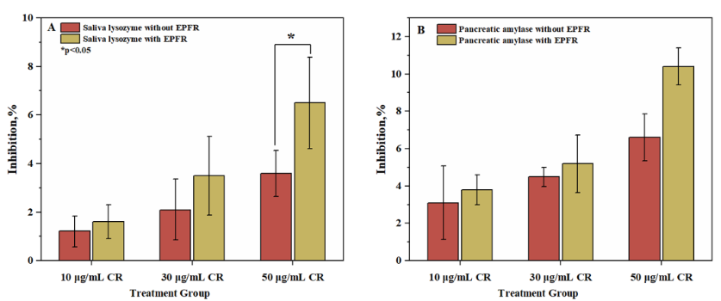
Emerging Health Risks of Crumb Rubber: Inhalation of Environmentally Persistent Free Radicals via Saliva
Poster By: Mason Swanton
Paper By: Quian’en Huang, Jianqun Wang, Jianping Wang, Dongmei Yu, Yuanbo Zhan, and Ze Liu
Department of Chemistry, Thompson Rivers University
Why I Chose This Article
This article was chosen as it is an easily relatable topic given that most areas use turf fields and they have grown in popularity over the last few years. Additionally, it helps to bring to light the health risks of these turf fields in hopes of remedying them.
Is the Current Sampling Plan Appropriate
This sampling procedure was appropriate for a few reasons:
The grab samples are a good idea as we don’t want to be mixing all the results. Instead, we would want to have individual before and after results for every individual to make sure that the differences in health, gender, and age don’t play a role in the analysis. If we did composite samples, we might not see little changes. This is especially important as an aspect of this study was to observe the effect of ESPRs in CR and how they can affect people. Therefore, it is good to have individuals to see if there are any trends found.
Systematic samples before and after also gives a baseline as a sort of “before exposure” measure to see the actual effects by measuring the difference after the 40mins of exercise.
Glass vials were then used according to the plastic free principle. All instruments and containers were made of stainless steel or glass and rinsed three times with demineralized water.
Adding sampling blanks may be of benefit, to see if airborne CR contaminated samples and, if so, how much.
Analytical Question
The study of this research article was to investigate the presence of crumb rubber (CR) in the ambient air of turf fields as well as in the saliva of people who used these artificial turf fields. By doing this, researchers hoped to answer the following questions:
To identify whether crumb rubber (CR) can appear in the saliva of someone who uses turf fields and to then analyze how CR affects saliva
To analyze how CR contributed to exposure to environmentally persistent free radicals (EPFRs) in the air and how we can improve our understanding of the health risks associated with this.
Fig 2. Flowchart of the questions to separate volunteers
Sampling Plan
To identify any crumb rubber in humans, 200 volunteers of various ages, sex, and physical condition were gathered and set to play on two fields: Field 5, a 1yr old field and Field 2, a 10yr old field.
Sampling Type: Grab Samples
Samples of saliva were taken for each individual and analyzed for CR along with trends in groups.
Sampling Strategy: Systematic Sampling
Samples were taken before and after 40 minutes of exercise on the two predetermined artificial turf fields.
Sample Storage:
Glass sample bottles were provided for the volunteers to collect around 5mL both before and after the 40-minute exercise. This resulted in around 9-16mL of saliva being collected per individual. Samples were then immediately covered with aluminum foil to prevent any airborne particle contamination.
Blanks:
No sampling blanks were made apparent.
Analytical Techniques After Sampling
Conclusion
From their testing, it was observed that CR did carry EPFRs and there was a measurable increase in CR and EPFRs in human saliva after activity on artificial turf fields. Testing of the effect on salivary enzymes found that CR inhibited both salivary amylase and salivary lysozyme.
This inhibition can lead to increased risk of dental caries, gingivitis, oral infection, and more. It could also lead to a decrease in immunity thus proving that artificial turf fields have health risks due to airborne CR.
Techniques for artificial saliva tests:
Temperature and pH adjustments
Samples were held at 37°C to mimic mouth temperature
pH was adjusted to 6.7 (mean pH of saliva)
Assay kits for enzyme activity determination
Both a-amylase and lysozyme
Techniques for saliva samples:
- Filtering
Samples were filtered through a 0.45µm filter
- Digestion and density separation
- Micro-Raman Spectroscopy
- Visual Identification
Fig 1. Visual representation of how the crumb rubber enters human saliva and its effects¹
Sample Matrix and Analytes
This experiment had two types of samples with their own analytes and matrices:
Air sampling
Analyte – Suspended atmospheric CR
Matrix – Atmospheric air
Saliva sampling (real and artificial)
Analyte – CR in saliva
Matrix – Human and artificial saliva
For this poster, the focus will be on the real saliva sampling.
Fig 4. Effects of CR on saliva enzyme inhibition.¹
References
(1) Huang, Q.; Wang, J.; Wang, J.; Yu, D.; Zhan, Y.; Liu, Z. Emerging Health Risks of Crumb Rubber: Inhalation of Environmentally Persistent Free Radicals via Saliva during Artificial Turf Activities. Environmental Science & Technology 2023, 57 (50), 21005–21015. https://doi.org/10.1021/acs.est.3c03278.
Fig 3. Increment of crumb rubber found in saliva before and after exercise on the artificial fields.¹

